Slide 1
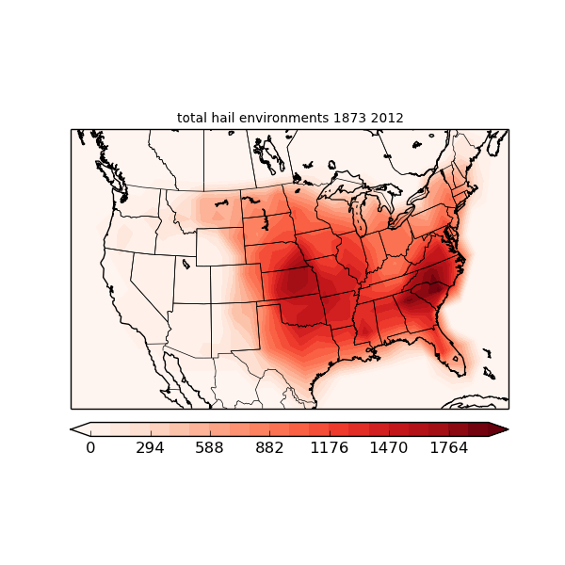
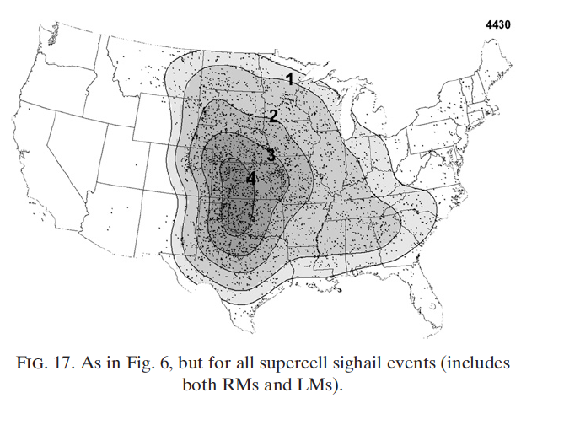
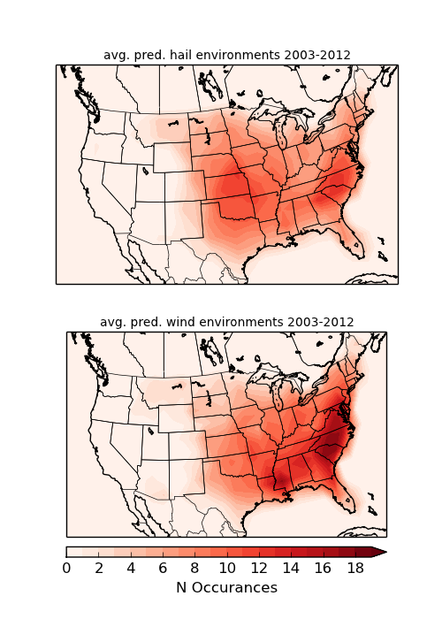
Hail
Hail > 2”, 2003-2011
Smith+2012

Slide 2
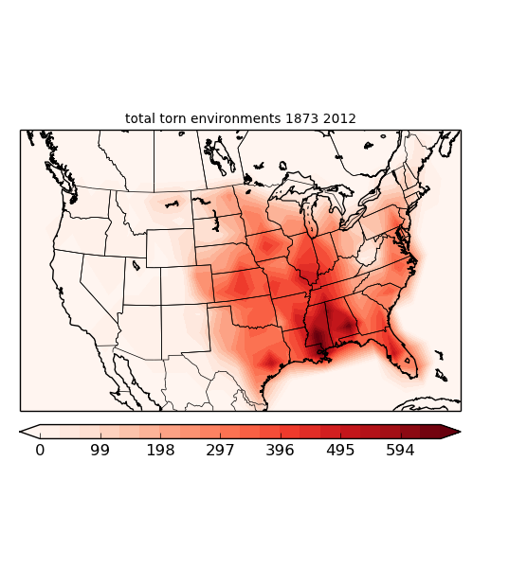
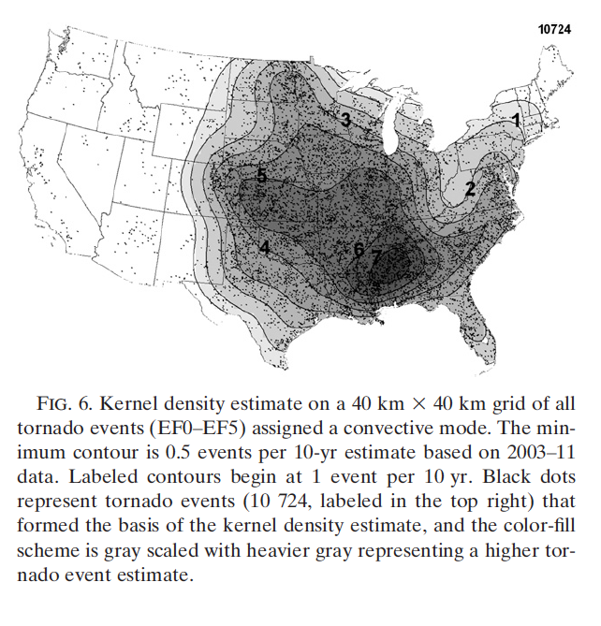
Tornado
Smith+2012

Slide 3
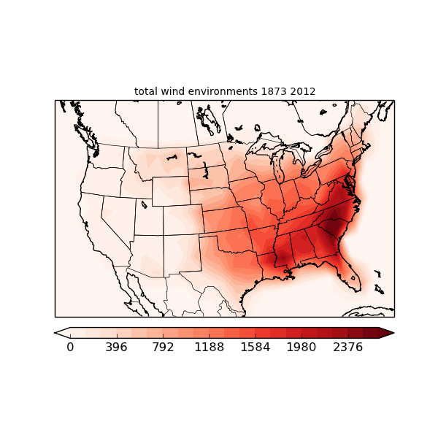
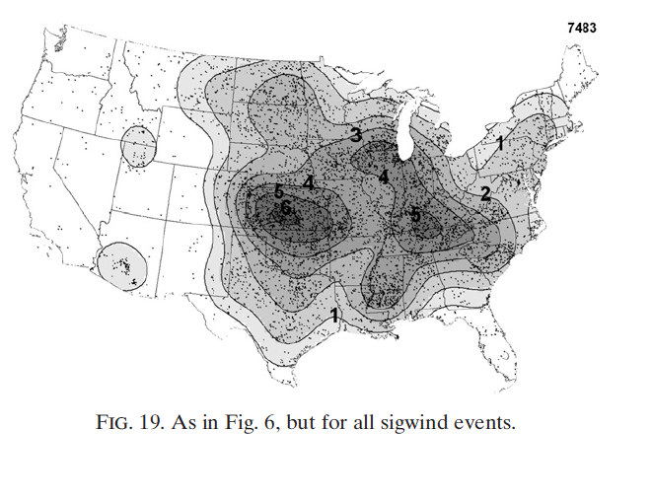
Wind
Wind > 65 knots, 2003-2011
Smith+2012

Slide 4
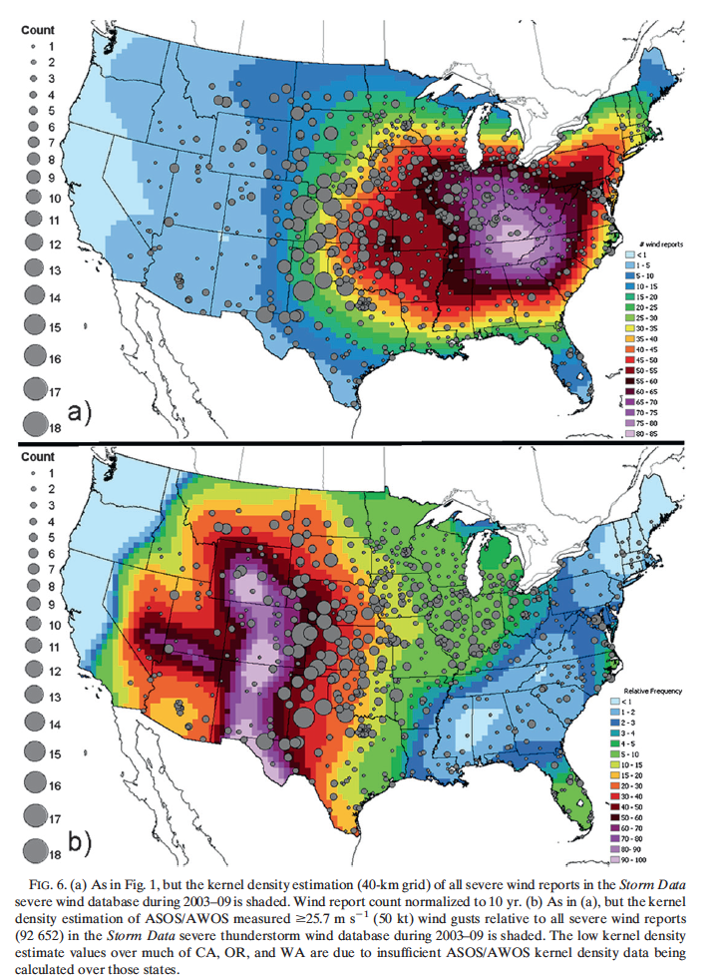
Wind
Smith+ 2013
dots – ASOS/AWOS thunderstorm
top – all severe winds in “Storm Data” 2003-2009
bottom – ASOS/AWOS

