Slide 1



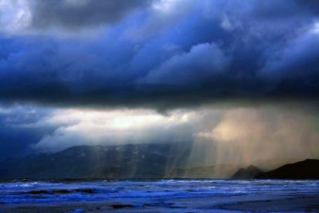
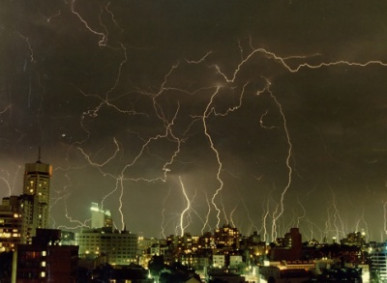
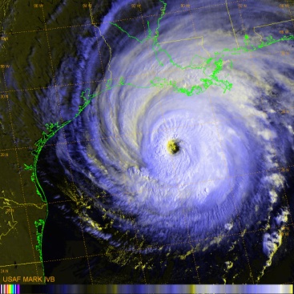
Diagnosis of Severe Weather
Environments in Canada
Jason Furtado, Mark Leidner, Lisa Wei, Guy Seeley
May 16, 2014
Notes:
40 min of prepared content
“Increase my time serving the customer & make it easy for them”
“Reduce my indemnity through fraud detection and loss control”
“Reduce clock time to stabilize my bulk reserves”
“Reduce operational risk through codifying the process”

Slide 2
Overview
Historical Canadian Severe Weather Insured Losses
Reanalysis Diagnosis Method Development
20th Century Reanalysis
Modern discriminant analysis
Performance
US Calibration
US/Canada PCS events
Canadian climatology
Long-term diagnosis (preliminary)
US/Canada

Slide 3
CAT losses in Canada

Slide 4
Top 10 CAT losses in Canada (1983-2013) All Perils
Date(s) Region Type loss loss (2013 $)
1 4-10 Jan 1998 Southern Quebec Ice storm 1,384,100 1,861,637
2 14-17 May 2011 Slave Lake AB Fire 742,000 759,947
3 19 Aug 2005 Ontario Wind/rainstorm 625,400 717,749
4 12 Aug 2012 Calgary Wind/thunderstorm 562,000 567,080
5 12 Jul 2010 Calgary and S. Alberta Wind/thunderstorm 530,000 558,661
6 7 Sep 1991 Calgary Hail 342,745 508,322
7 1 Aug 2009 Alberta Wind/thunderstorm 376,300 403,930
8 6 Jun 2005 Alberta Flooding 300,000 344,299
9 19 Jul 1996 Saguenay QC Flooding 207,159 286,154
10 31 Jul 1987 Edmonton Tornado 148,377 265,996
Source: IBC

Slide 5
Top 10 CAT losses in Canada (1983-2013) All Perils
Date(s) Region Type loss loss (2013 $)
1 4-10 Jan 1998 Southern Quebec Ice storm 1,384,100 1,861,637
2 14-17 May 2011 Slave Lake AB Fire 742,000 759,947
3 19 Aug 2005 Ontario Wind/rainstorm 625,400 717,749
4 12 Aug 2012 Calgary Wind/thunderstorm 562,000 567,080
5 12 Jul 2010 Calgary and S. Alberta Wind/thunderstorm 530,000 558,661
6 7 Sep 1991 Calgary Hail 342,745 508,322
7 1 Aug 2009 Alberta Wind/thunderstorm 376,300 403,930
8 6 Jun 2005 Alberta Flooding 300,000 344,299
9 19 Jul 1996 Saguenay QC Flooding 207,159 286,154
10 31 Jul 1987 Edmonton Tornado 148,377 265,996
Source: IBC

Slide 6
Top 10 CAT losses in Canada (1983-2013) Thunderstorm/Hail/Tornado only
Date(s) Region Type loss loss (2013 $)
1 12 Aug 2012 Calgary Wind/thunderstorm 562,000 567,080
2 12-13 Jul 2010 Calgary and S. Alberta Wind/thunderstorm 530,000 558,661
3 7 Sep 1991 Calgary Hail 342,745 508,322
4 1-3 Aug 2009 Alberta Wind/thunderstorm 376,300 403,930
5 31 Jul 1987 Edmonton Tornado 148,377 265,996
6 26-29 May 2012 Thunder Bay ON, Montreal QC Wind/thunderstorm 259,700 262,047
7 24-28 Jul 2009 Ontario Wind/thunderstorm 227,900 244,634
8 27-Nov-11 Alberta Wind/thunderstorm 238,500 244,269
9 2-11 Jul 2004 Edmonton Hail 166,000 194,697
10 12 May 2000 Southern Ontario Storm 128,121 164,919
Source: IBC

Slide 7
Overview
Historical Canadian Severe Weather Insured Losses
Reanalysis Diagnosis Method Development
20th Century Reanalysis
Modern discriminant analysis
Performance
US Calibration
US/Canada PCS events
Canadian climatology
Long-term diagnosis (preliminary)
US/Canada

Slide 8
Using reanalysis for change detection
Motivation:
Are the conditions that give rise to severe weather changing in the US and Canada?
Spotter record has severe inherent sampling biases further back in time
Use reanalyses to identify shifts in frequency, coverage and location
New variant: extensions of discriminant analysis
Choice of key environmental parameters
Support Vector Machine (SVM) training & results

Slide 9
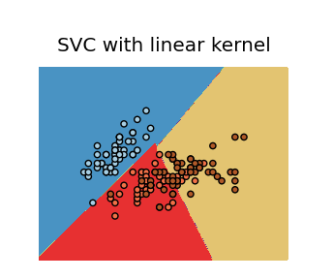
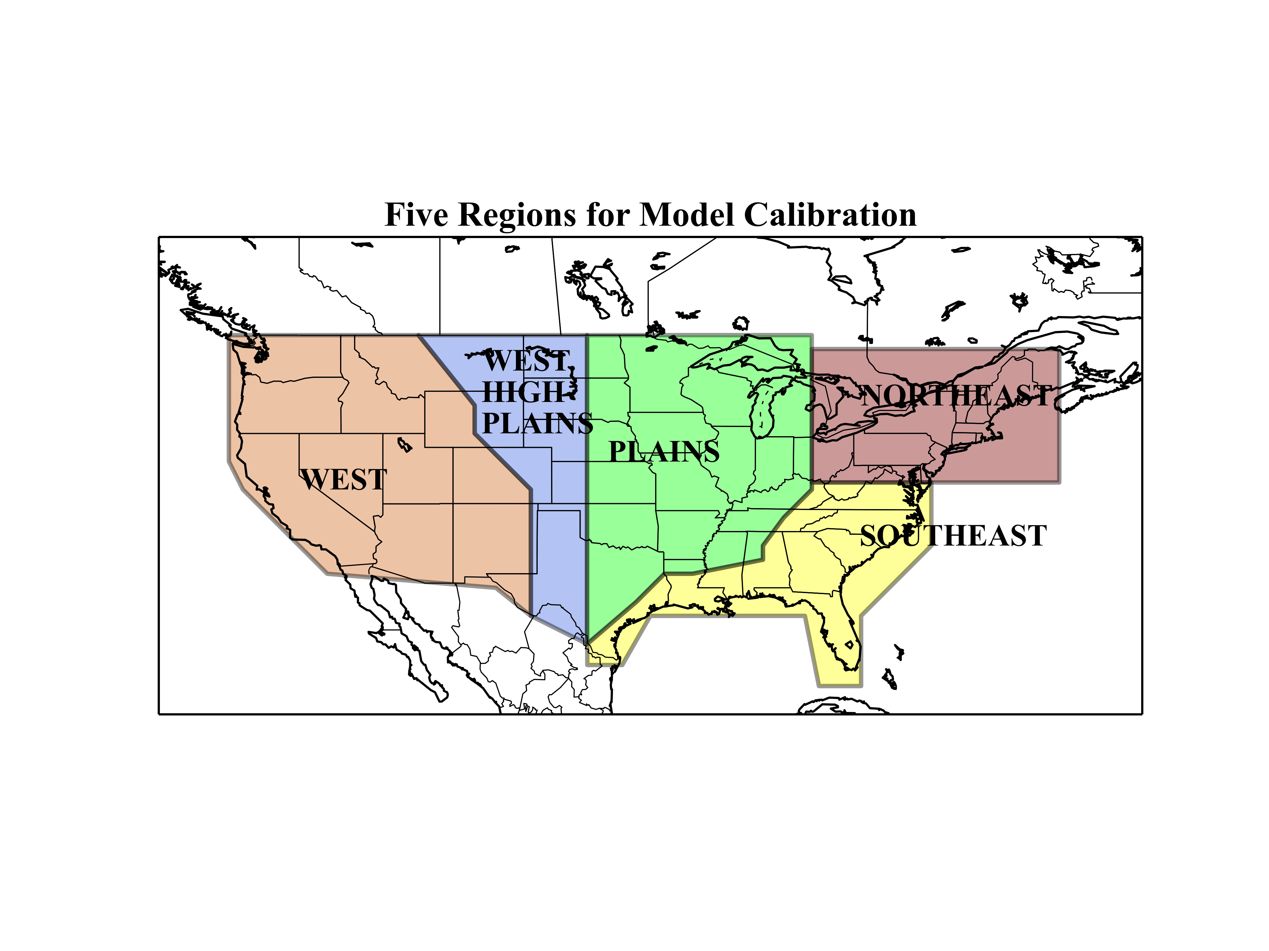
New variant: extensions of discriminant analysis
Choice of key environmental parameters
Use 20th Century Reanalysis [Compo et al., 2011]
CAPE, 0-6km Shear, 2-4 km lapse rate, negative low-level divergence (i.e., convergence)
Mean-normalized to local+temporal 20 year mean
Support Vector Machine (SVM/SVC) training
Linear plane to separate parameters in hyperplane resulting in hail/tornado/wind
Train each peril by region
Compo, G. R., and Coauthors, 2011: The Twentieth Century Reanalysis Product. Quart. J. Roy Meteor. Soc., 137, 1-28.

Slide 10
Overview
Historical Canadian Severe Weather Insured Losses
Reanalysis Diagnosis Method Development
20th Century Reanalysis
Modern discriminant analysis
Performance
US Calibration
US/Canada PCS events
Canadian climatology
Long-term diagnosis (preliminary)
US/Canada

Slide 11
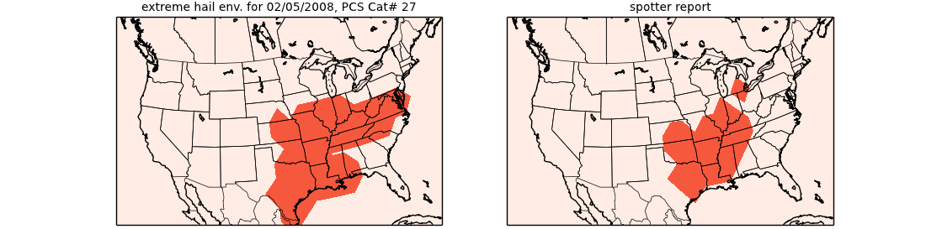
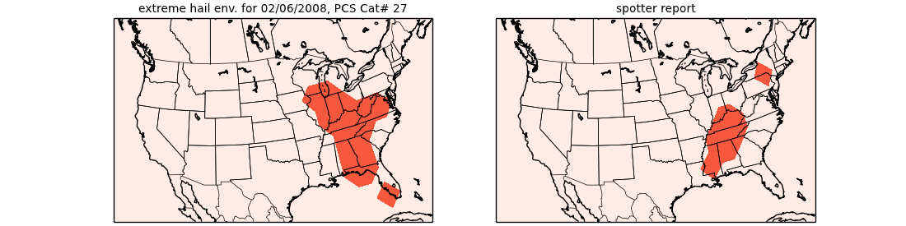
Diagnosing severe environments CAT #27, Feb 5-6, 2008, AL, AR, IN, KY, MS, OH, TN, TX
Hail

Slide 12
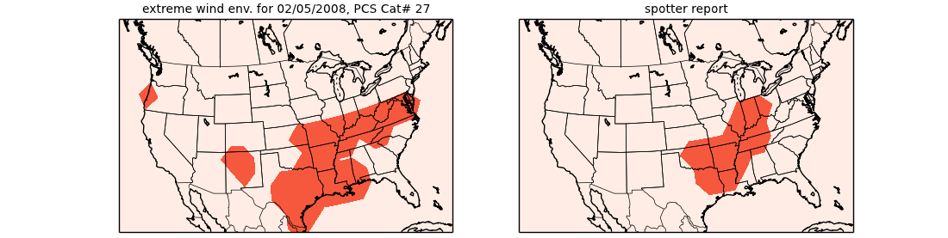
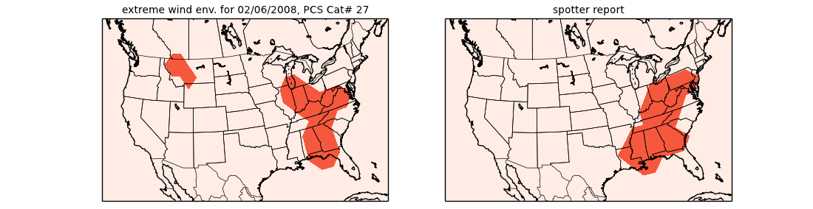
Diagnosing severe environments CAT #27, Feb 5-6, 2008, AL, AR, IN, KY, MS, OH, TN, TX
Wind

Slide 13
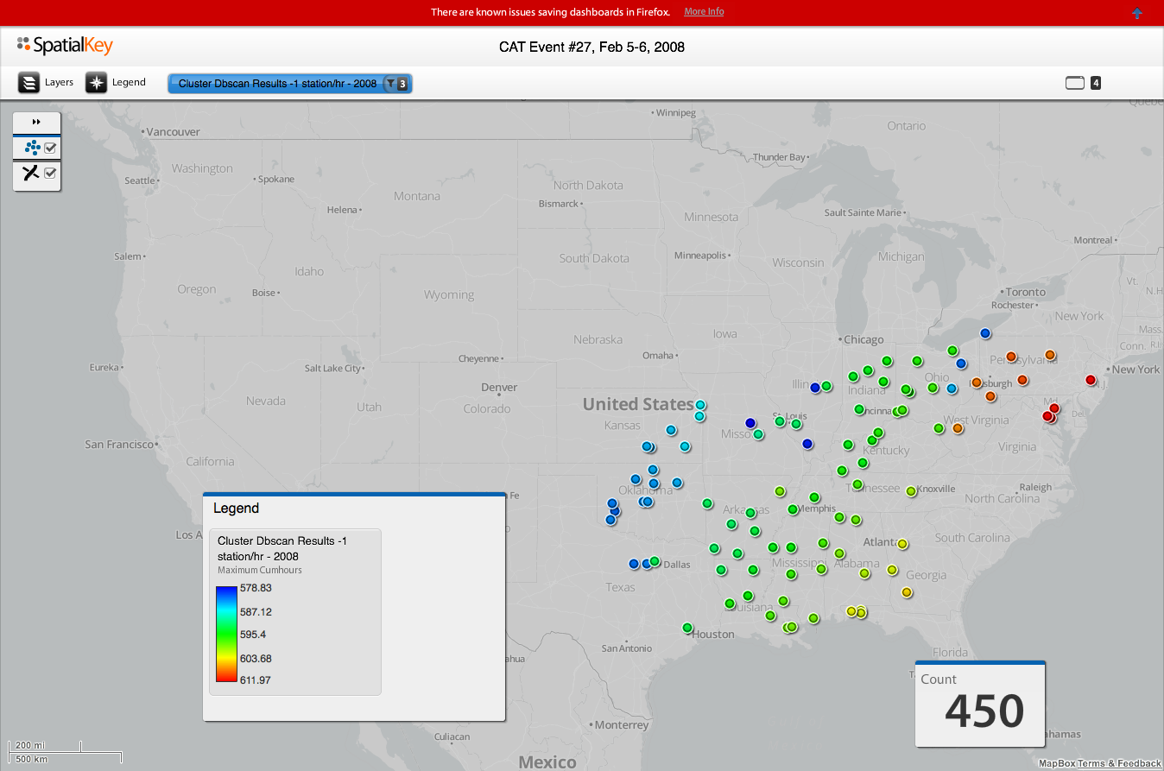
NIST extreme wind gusts CAT #27, Feb 5-6, 2008, AL, AR, IN, KY, MS, OH, TN, TX
Wind
Colors = time progression of wind reports
Measure of time

Slide 14
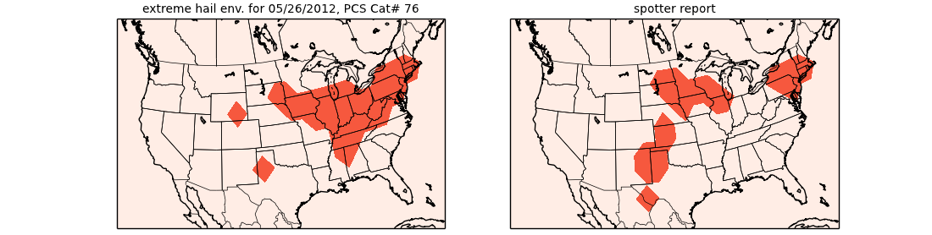
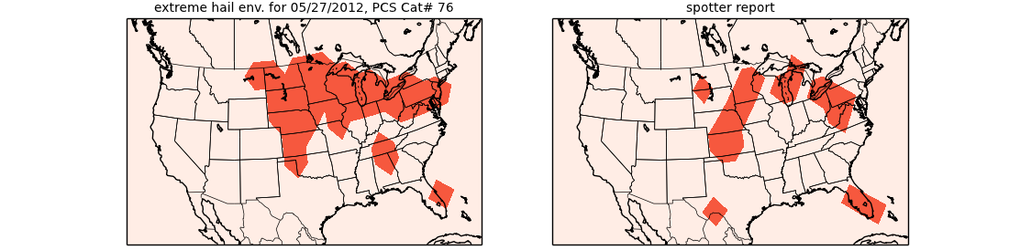
Diagnosing severe environments CAT #76, May 25-30, 2012, KS, MN, NY, OK, PA, TX
Hail

Slide 15
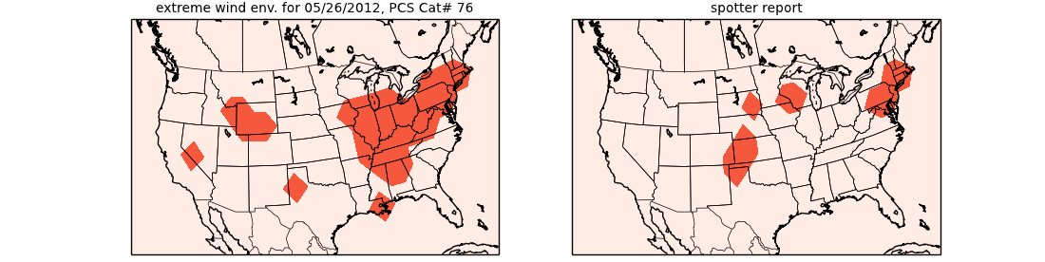
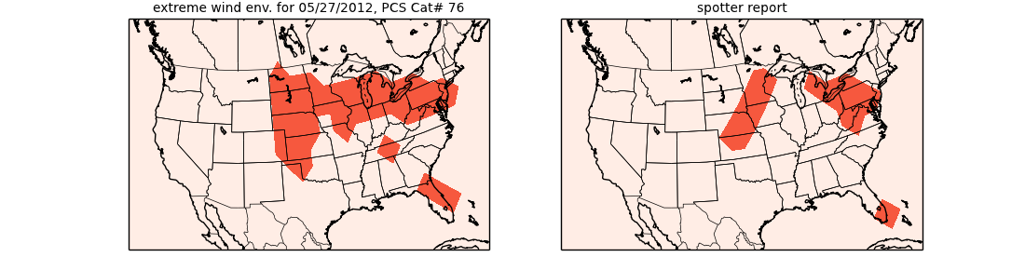
Diagnosing severe environments CAT #76, May 25-30, 2012, KS, MN, NY, OK, PA, TX
Wind

Slide 16
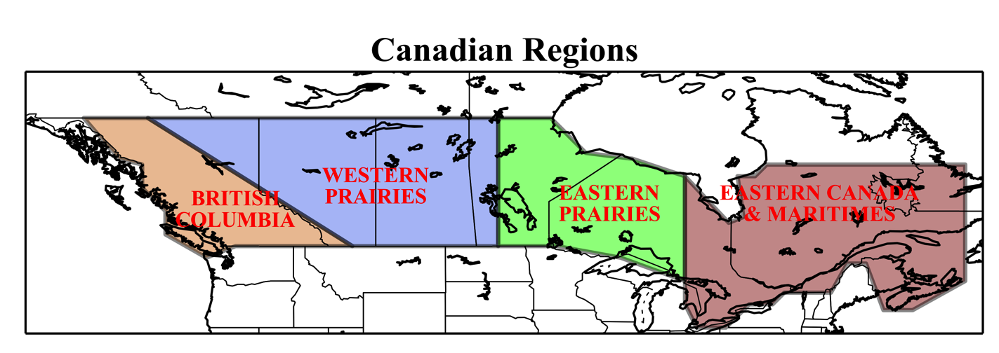
4 Canadian Regions, aligned with calibrated US models

Slide 17
Top 10 CAT losses in Canada (1983-2013) Thunderstorm/Hail/Tornado only
Date(s) Region Type loss loss (2013 $)
1 12 Aug 2012 Calgary Wind/thunderstorm 562,000 567,080
2 12-13 Jul 2010 Calgary and S. Alberta Wind/thunderstorm 530,000 558,661
3 7 Sep 1991 Calgary Hail 342,745 508,322
4 1-3 Aug 2009 Alberta Wind/thunderstorm 376,300 403,930
5 31 Jul 1987 Edmonton Tornado 148,377 265,996
6 26-29 May 2012 Thunder Bay ON, Montreal QC Wind/thunderstorm 259,700 262,047
7 24-28 Jul 2009 Ontario Wind/thunderstorm 227,900 244,634
8 27-Nov-11 Alberta Wind/thunderstorm 238,500 244,269
9 2-11 Jul 2004 Edmonton Hail 166,000 194,697
10 12 May 2000 Southern Ontario Storm 128,121 164,919
Source: IBC

Slide 18
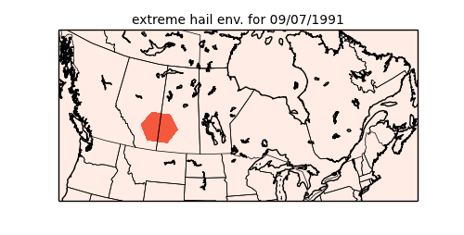
Diagnosing severe environments loss (2013 $) September 7, 1991, Calgary, AB $508,322,000
Hail
Calgary

Slide 19
Top 10 CAT losses in Canada (1983-2013) Thunderstorm/Hail/Tornado only
Date(s) Region Type loss loss (2013 $)
1 12 Aug 2012 Calgary Wind/thunderstorm 562,000 567,080
2 12-13 Jul 2010 Calgary and S. Alberta Wind/thunderstorm 530,000 558,661
3 7 Sep 1991 Calgary Hail 342,745 508,322
4 1-3 Aug 2009 Alberta Wind/thunderstorm 376,300 403,930
5 31 Jul 1987 Edmonton Tornado 148,377 265,996
6 26-29 May 2012 Thunder Bay ON, Montreal QC Wind/thunderstorm 259,700 262,047
7 24-28 Jul 2009 Ontario Wind/thunderstorm 227,900 244,634
8 27-Nov-11 Alberta Wind/thunderstorm 238,500 244,269
9 2-11 Jul 2004 Edmonton Hail 166,000 194,697
10 12 May 2000 Southern Ontario Storm 128,121 164,919
Source: IBC

Slide 20
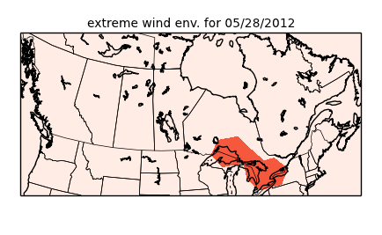
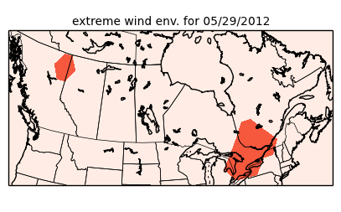
Diagnosing severe environments loss (2013 $) May 27-28, 2012, Thunder Bay, ON, and Montreal, QC $262,047,000
Wind/Thunderstorm
Thunder Bay
Montreal

Slide 21
Top 10 CAT losses in Canada (1983-2013) Thunderstorm/Hail/Tornado only
Date(s) Region Type loss loss (2013 $)
1 12 Aug 2012 Calgary Wind/thunderstorm 562,000 567,080
2 12-13 Jul 2010 Calgary and S. Alberta Wind/thunderstorm 530,000 558,661
3 7 Sep 1991 Calgary Hail 342,745 508,322
4 1-3 Aug 2009 Alberta Wind/thunderstorm 376,300 403,930
5 31 Jul 1987 Edmonton Tornado 148,377 265,996
6 26-29 May 2012 Thunder Bay ON, Montreal QC Wind/thunderstorm 259,700 262,047
7 24-28 Jul 2009 Ontario Wind/thunderstorm 227,900 244,634
8 27-Nov-11 Alberta Wind/thunderstorm 238,500 244,269
9 2-11 Jul 2004 Edmonton Hail 166,000 194,697
10 12 May 2000 Southern Ontario Storm 128,121 164,919
Source: IBC

Slide 22
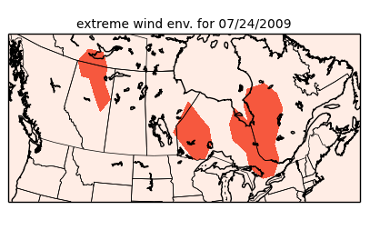
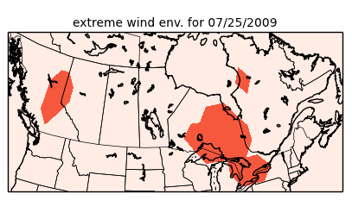
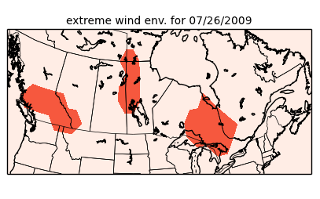
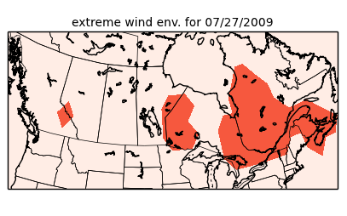
Diagnosing severe environments loss (2013 $) July 24-28, 2009, Ontario $244,634,000
Wind/Thunderstorm
Ontario
Ontario
Ontario
Ontario

Slide 23
Top 10 CAT losses in Canada (1983-2013) Thunderstorm/Hail/Tornado only
Date(s) Region Type loss loss (2013 $)
1 12 Aug 2012 Calgary Wind/thunderstorm 562,000 567,080
2 12-13 Jul 2010 Calgary and S. Alberta Wind/thunderstorm 530,000 558,661
3 7 Sep 1991 Calgary Hail 342,745 508,322
4 1-3 Aug 2009 Alberta Wind/thunderstorm 376,300 403,930
5 31 Jul 1987 Edmonton Tornado 148,377 265,996
6 26-29 May 2012 Thunder Bay ON, Montreal QC Wind/thunderstorm 259,700 262,047
7 24-28 Jul 2009 Ontario Wind/thunderstorm 227,900 244,634
8 27-Nov-11 Alberta Wind/thunderstorm 238,500 244,269
9 2-11 Jul 2004 Edmonton Hail 166,000 194,697
10 12 May 2000 Southern Ontario Storm 128,121 164,919
Source: IBC

Slide 24
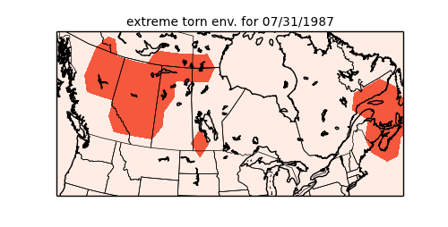
Diagnosing severe environments loss (2013 $) July 31, 1987, Edmonton, AB $265,996,000
Tornado
Edmonton

Slide 25
Canadian Hail Climatology Etkin & Brun 1999

Slide 26
Canadian Hail Climatology Etkin & Brun 1999

Slide 27
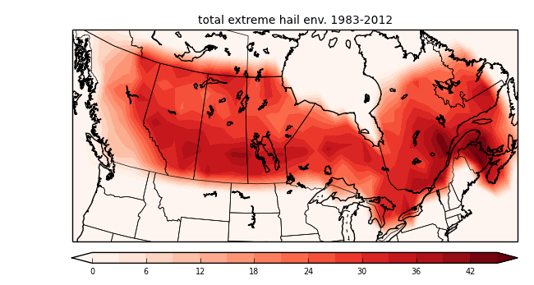
Canadian Hail Climatology Environment Canada 1988
Diagnosed severe hail environments, PCS events

Slide 28
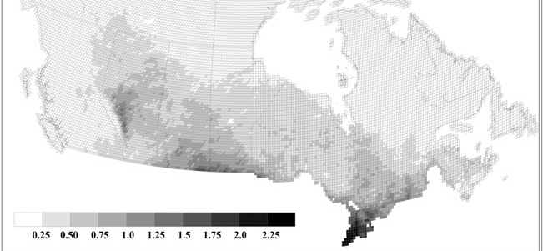
Canadian Hail Climatology Lightning climatology
Diagnosed severe hail environments, PCS events

Slide 29
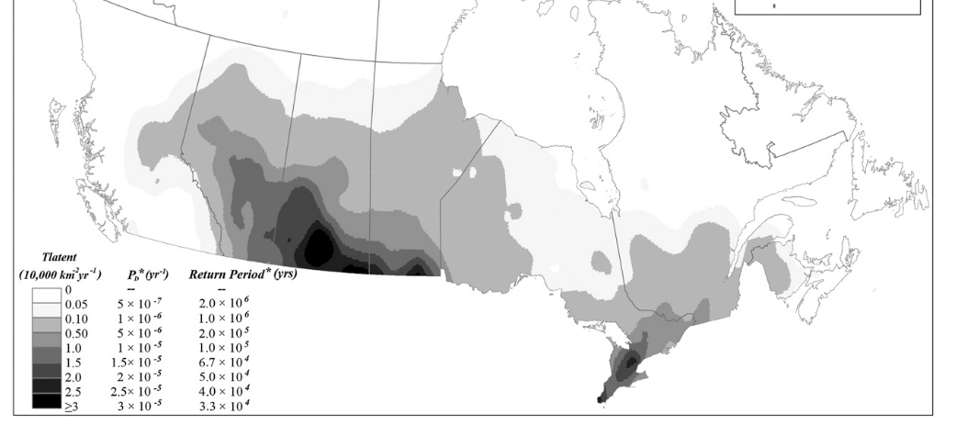
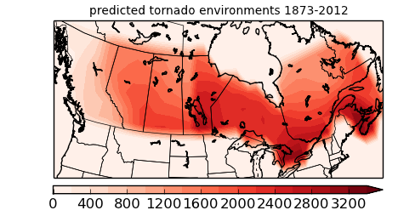
Canadian Tornado Climatology
Diagnosed tornado environments

Slide 30
Overview
Historical Canadian Severe Weather Insured Losses
Reanalysis Diagnosis Method Development
20th Century Reanalysis
Modern discriminant analysis
Performance
US Calibration
US/Canada PCS events
Canadian climatology
Long-term diagnosis (preliminary)
US/Canada

Slide 31
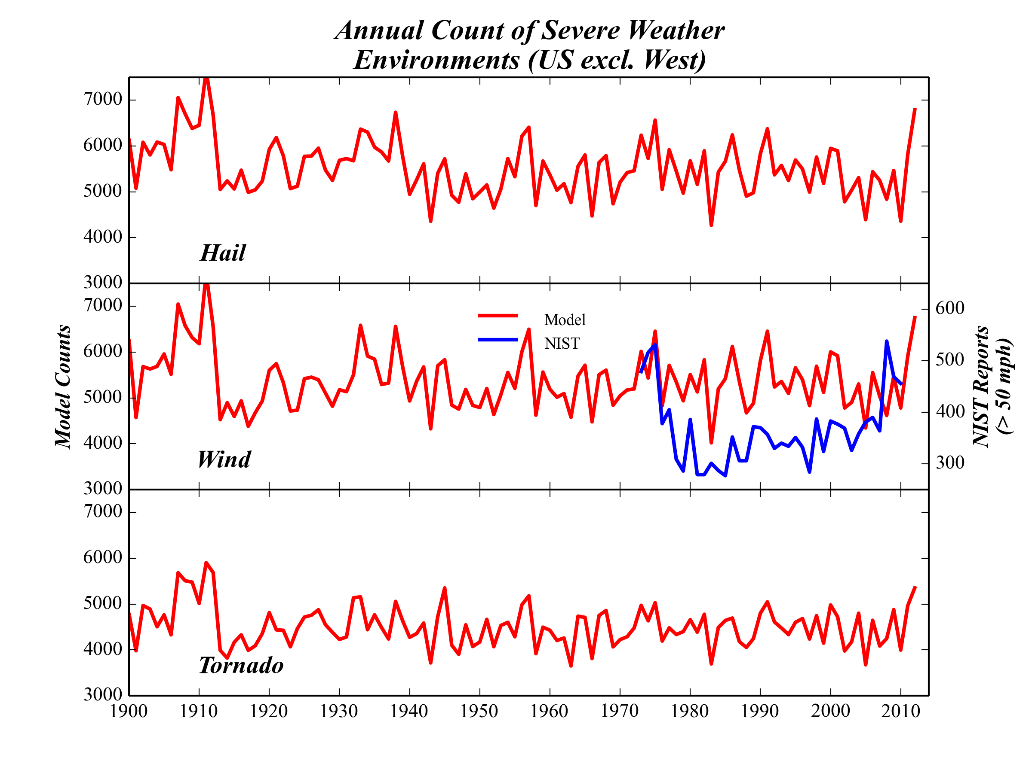
Long-term diagnosis of severe environments US
# of severe weather environments

Slide 32
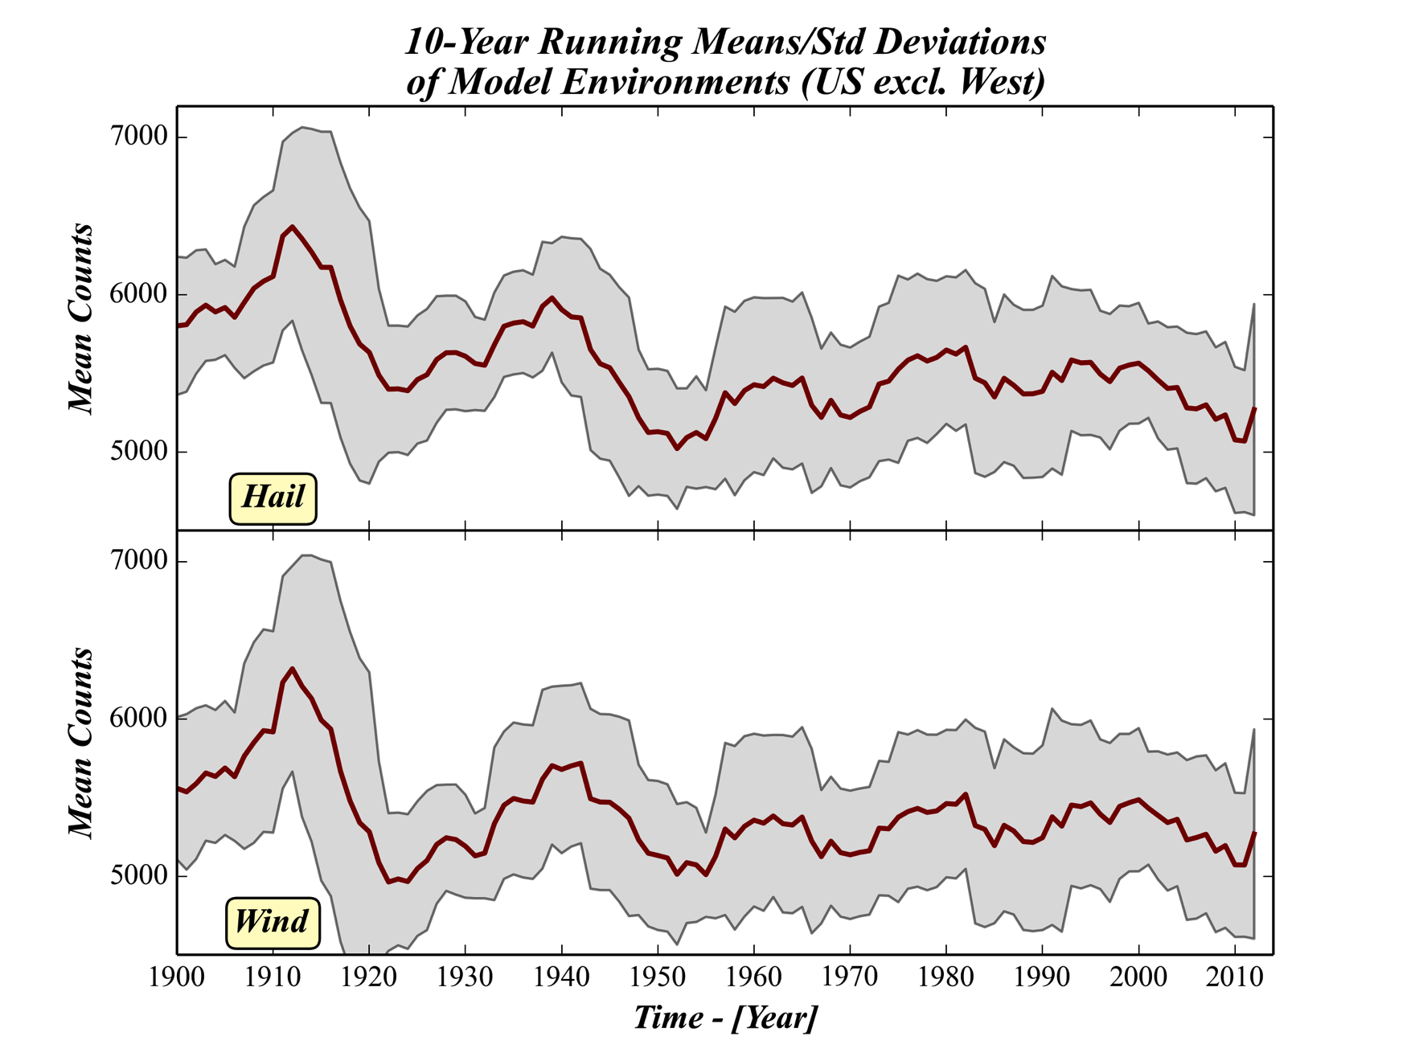
Long-term diagnosis of severe environments US
red: 10-year running average
shaded grey: 10 year running standard deviation

Slide 33
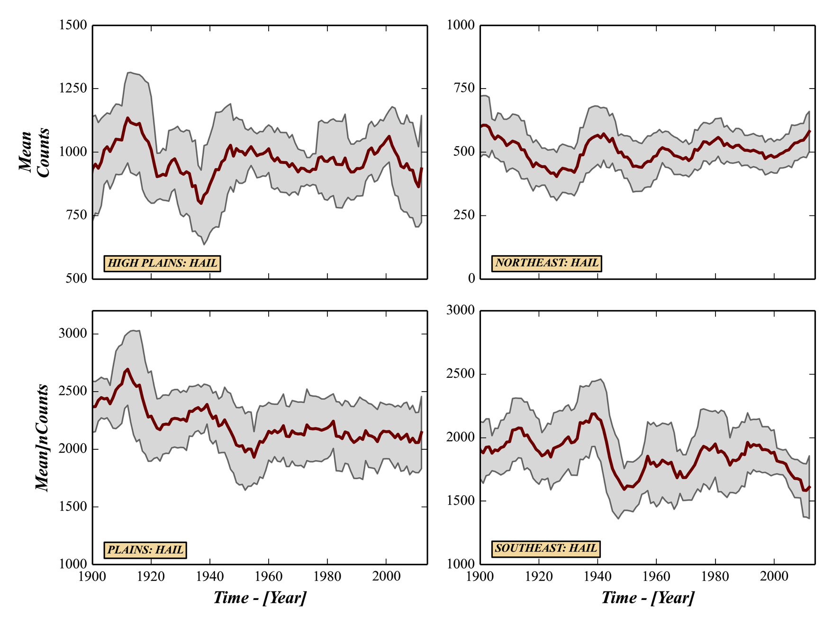
Long-term regional diagnosis severe hail environments, US
red: 10-year running average
shaded grey: 10 year running standard deviation

Slide 34
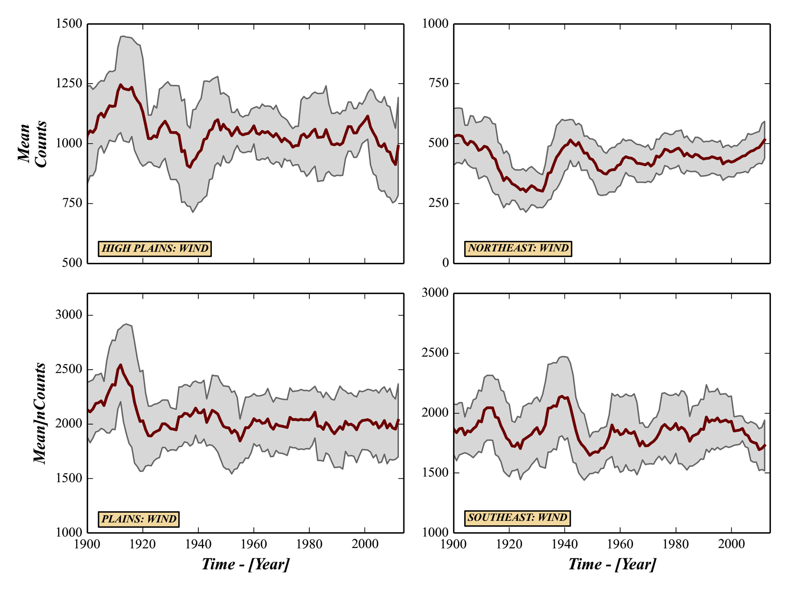
Long-term regional diagnosis severe wind environments, US
red: 10-year running average
shaded grey: 10 year running standard deviation

Slide 35
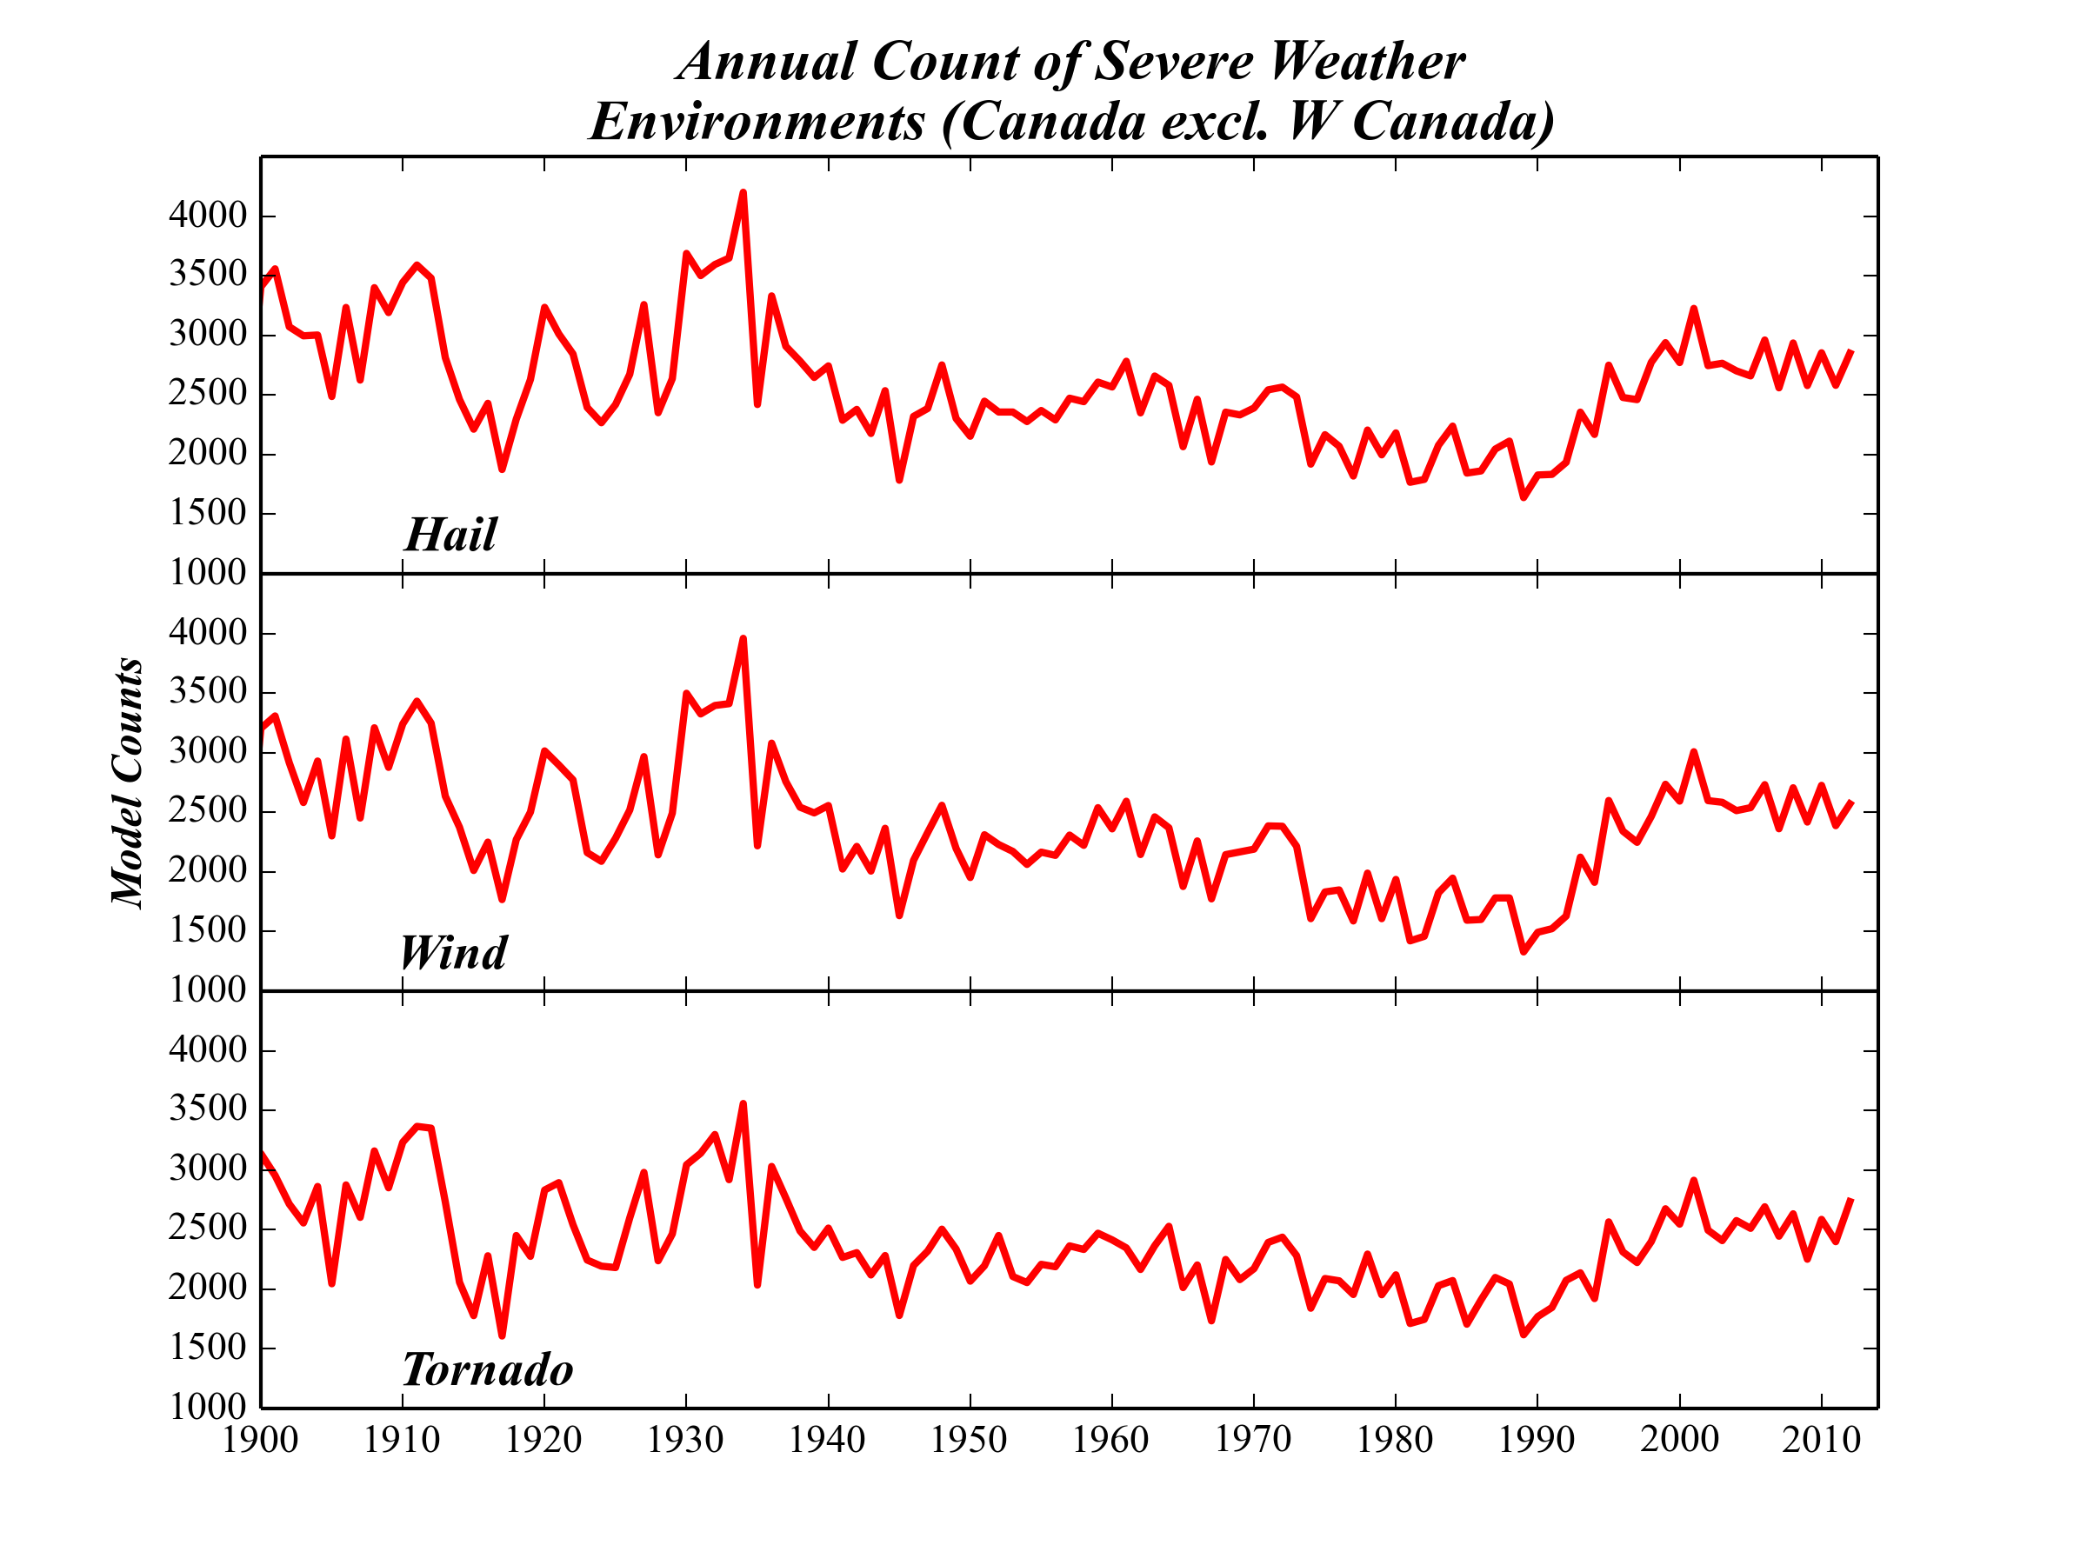
Long-term diagnosis of severe environments Canada
# of severe weather environments

Slide 36
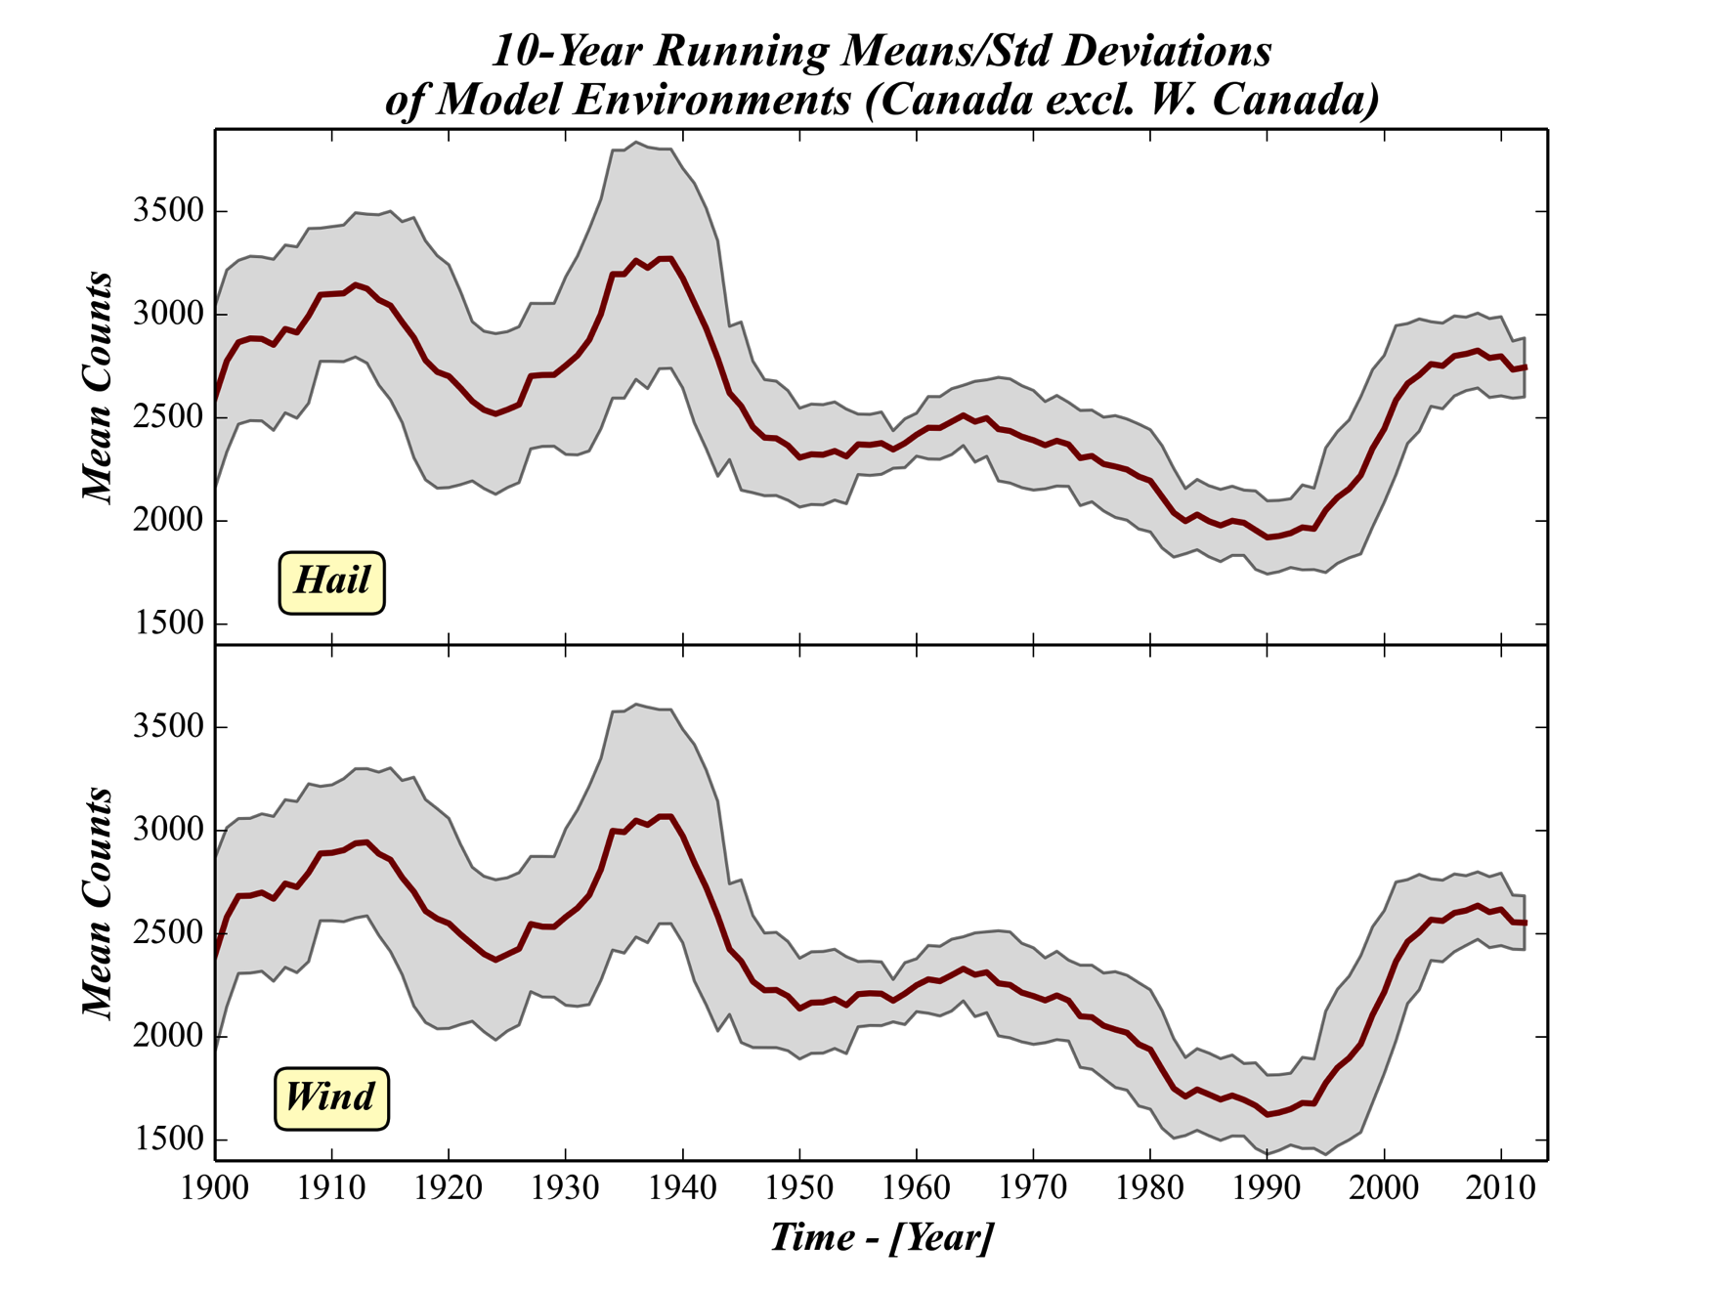
Long-term diagnosis of severe environments Canada
red: 10-year running average
shaded grey: 10 year running standard deviation

Slide 37
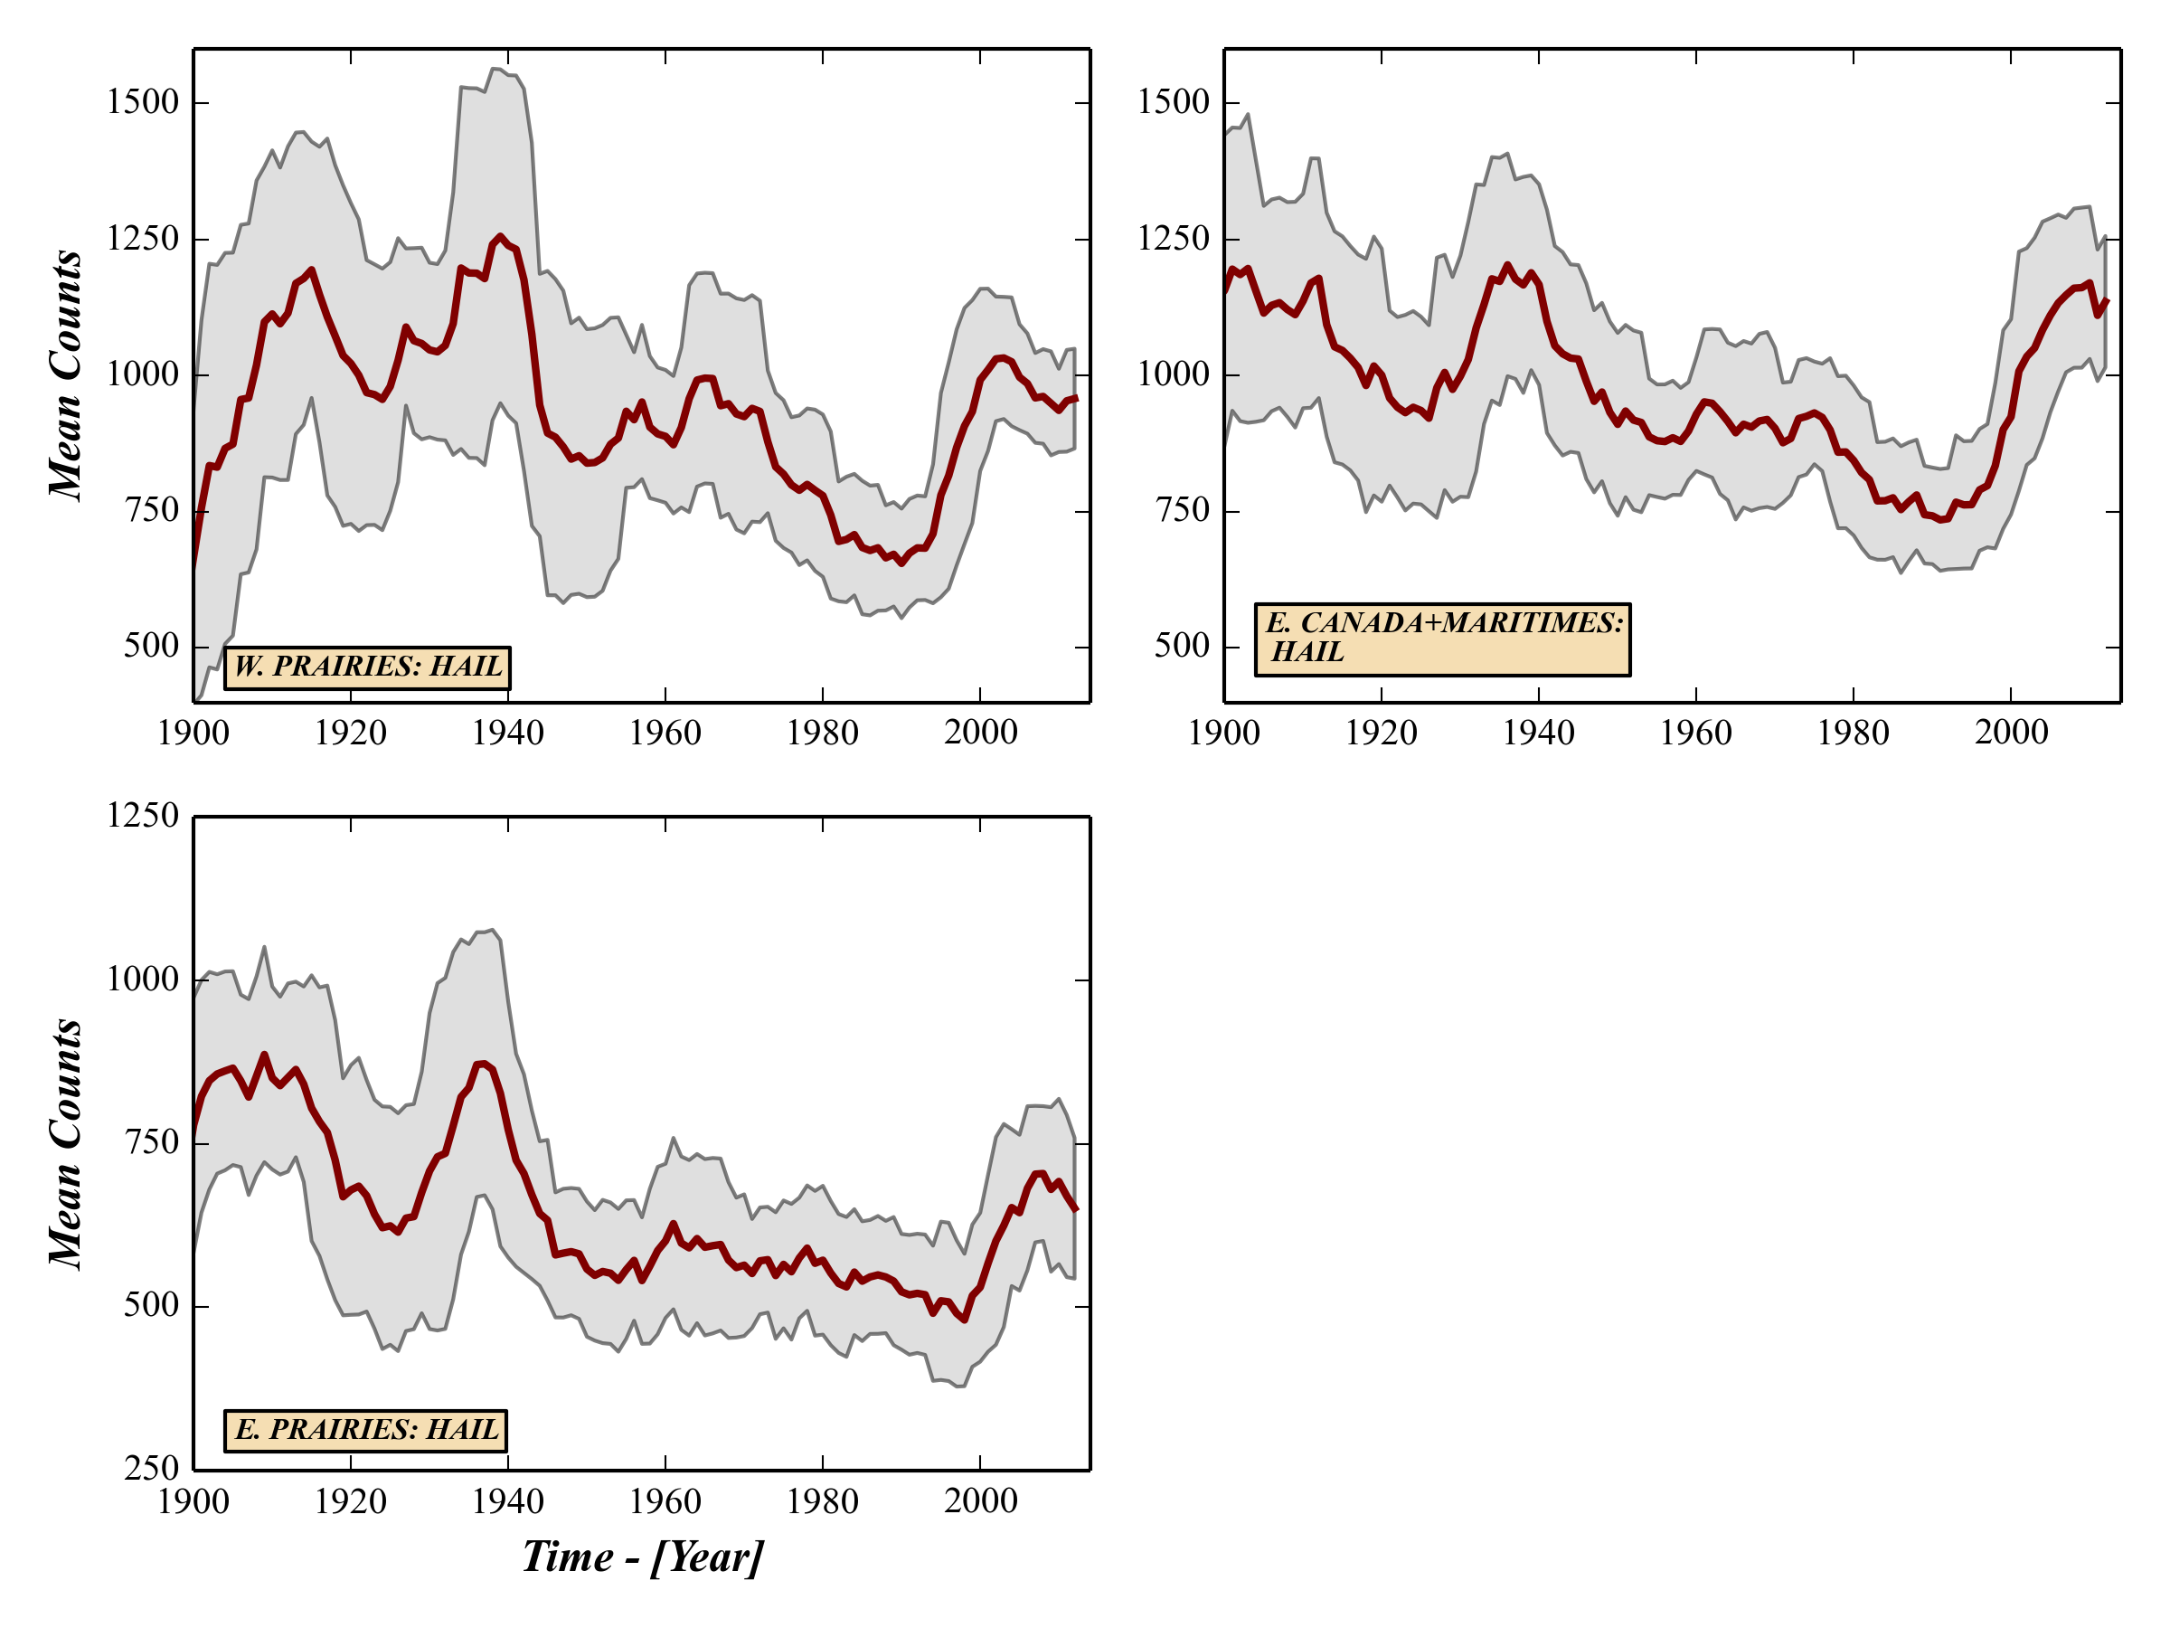
Long-term regional diagnosis severe hail environments, Canada
red: 10-year running average
shaded grey: 10 year running standard deviation

Slide 38
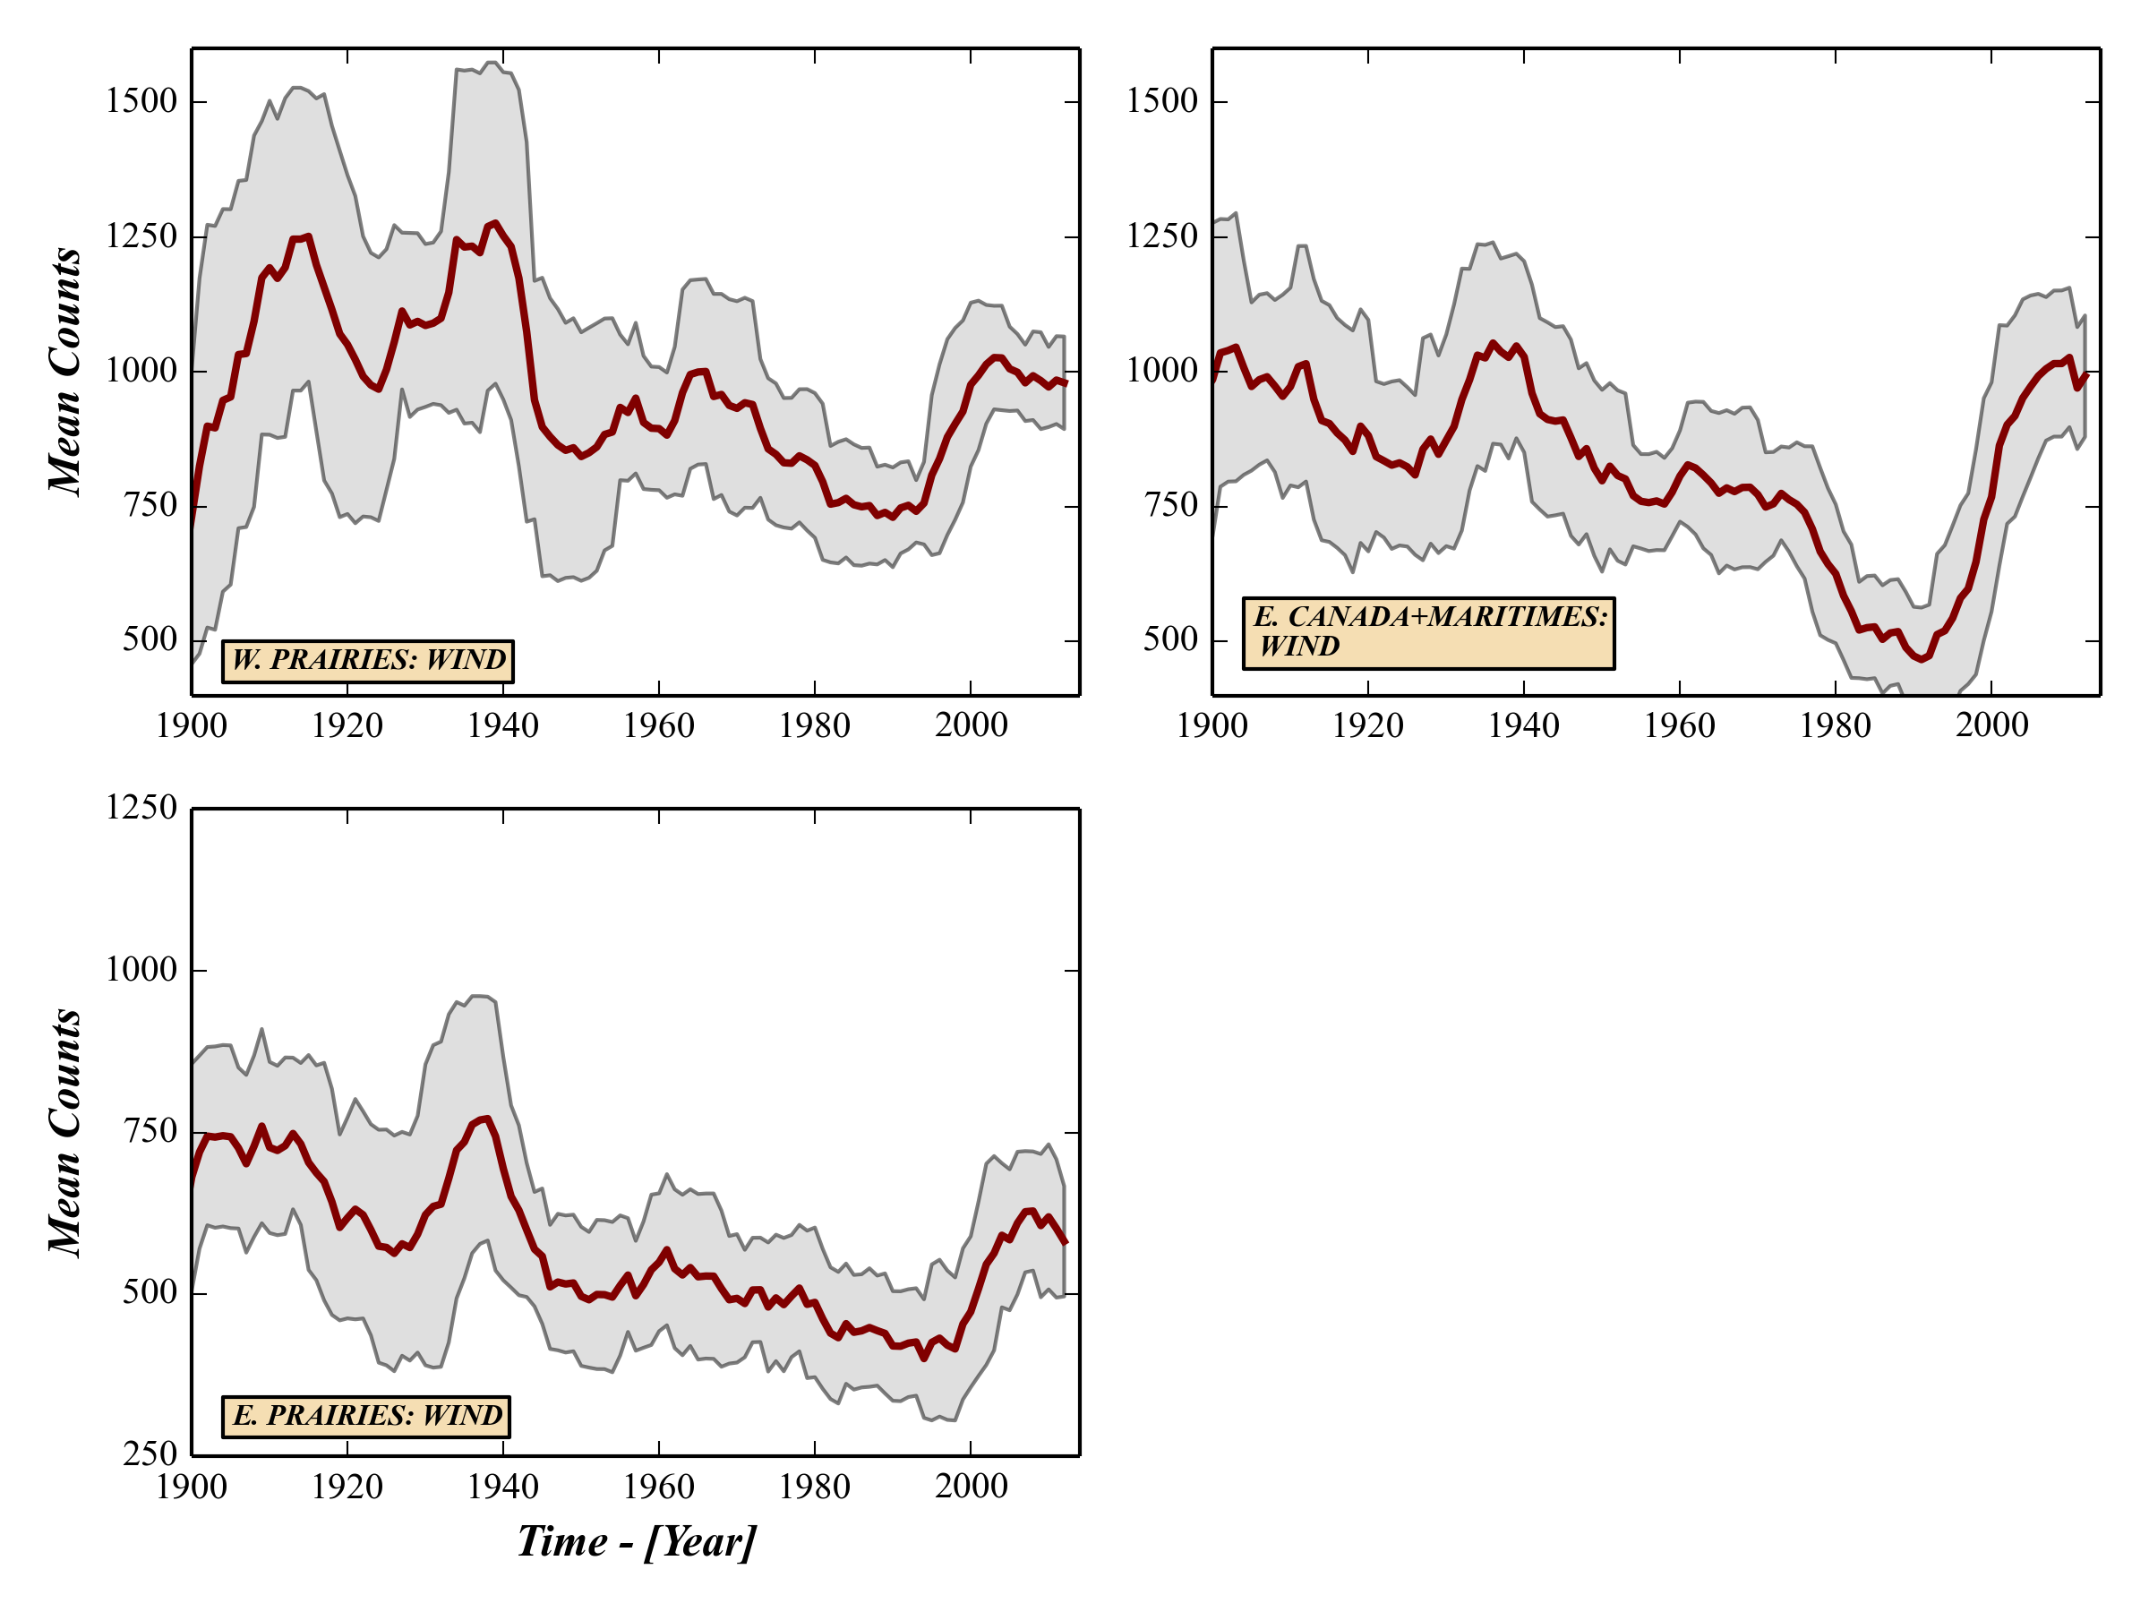
Long-term regional diagnosis severe wind environments, Canada
red: 10-year running average
shaded grey: 10 year running standard deviation

Slide 39
Summary & In Progress
Summary
Developed model characterizing historical severe weather environments based on 20th Century Reanalysis data
Model performed well compared to US & Canadian severe weather events and climatology
Produced preliminary long-term diagnostics for Canada back through the 20th century
In Progress:
Continue to validate and refine long-term diagnosis
Evaluate long-term, inter- and intra-regional variations
Evaluate seasonality of severe weather environments

Slide 40
Extra Slides

Slide 41
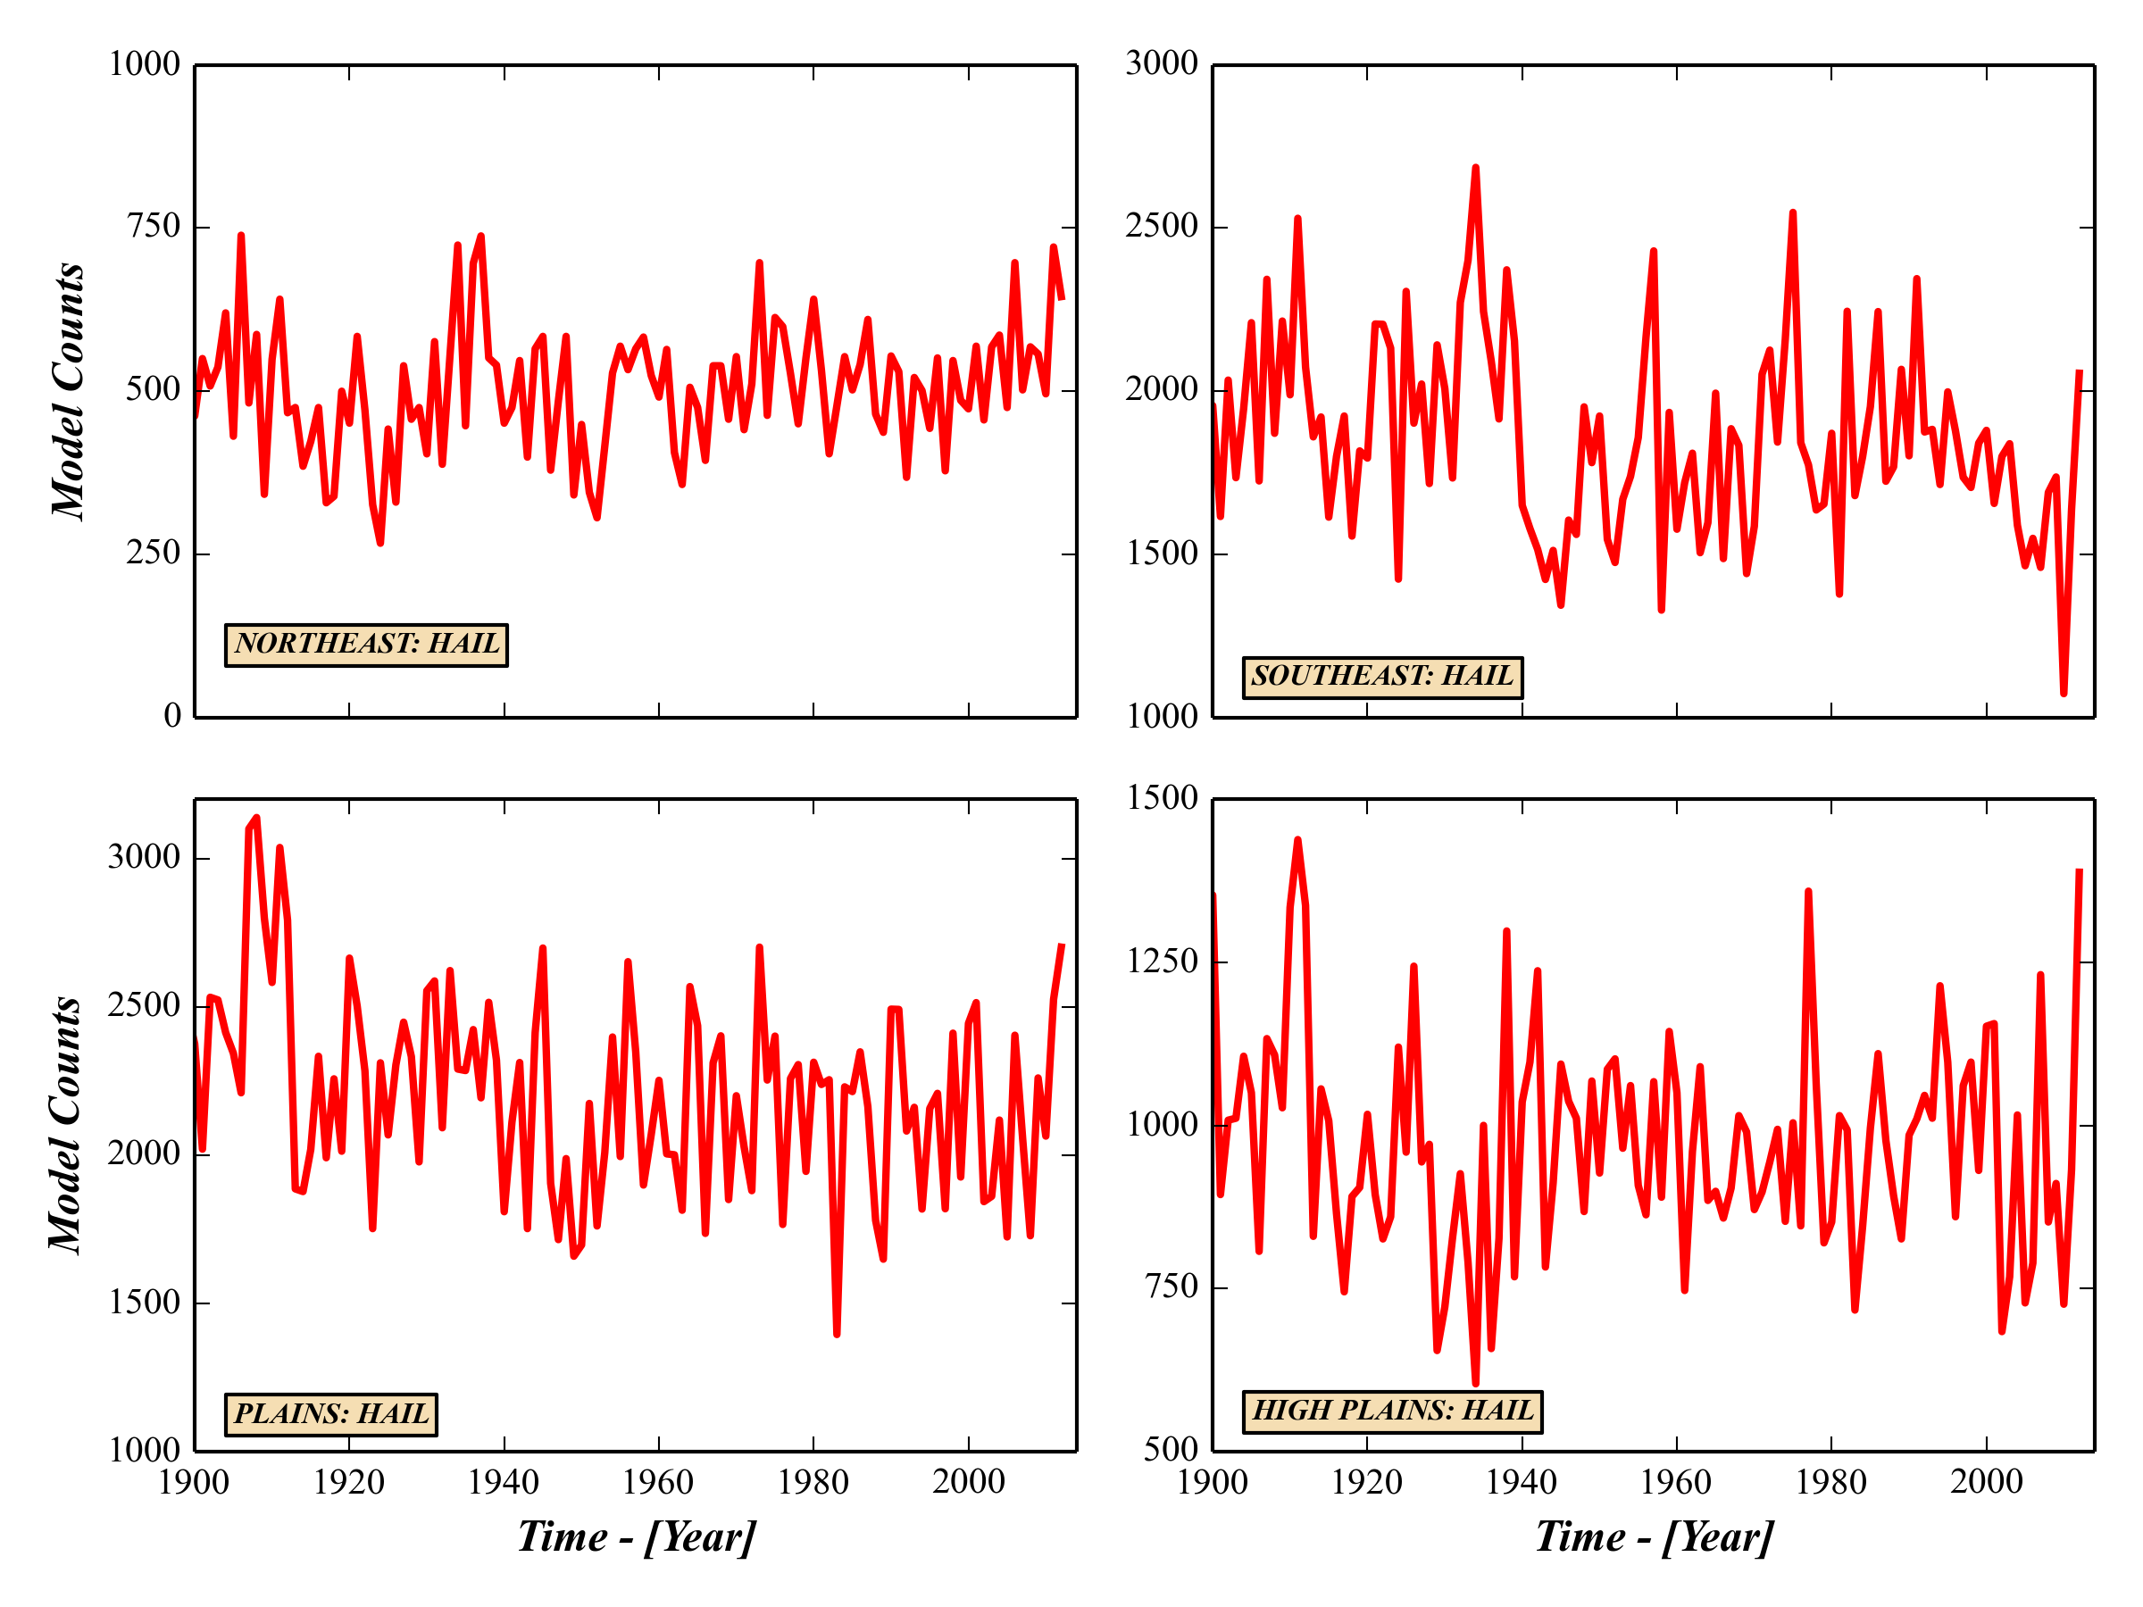
Long-term regional diagnosis severe hail environments, US

Slide 42
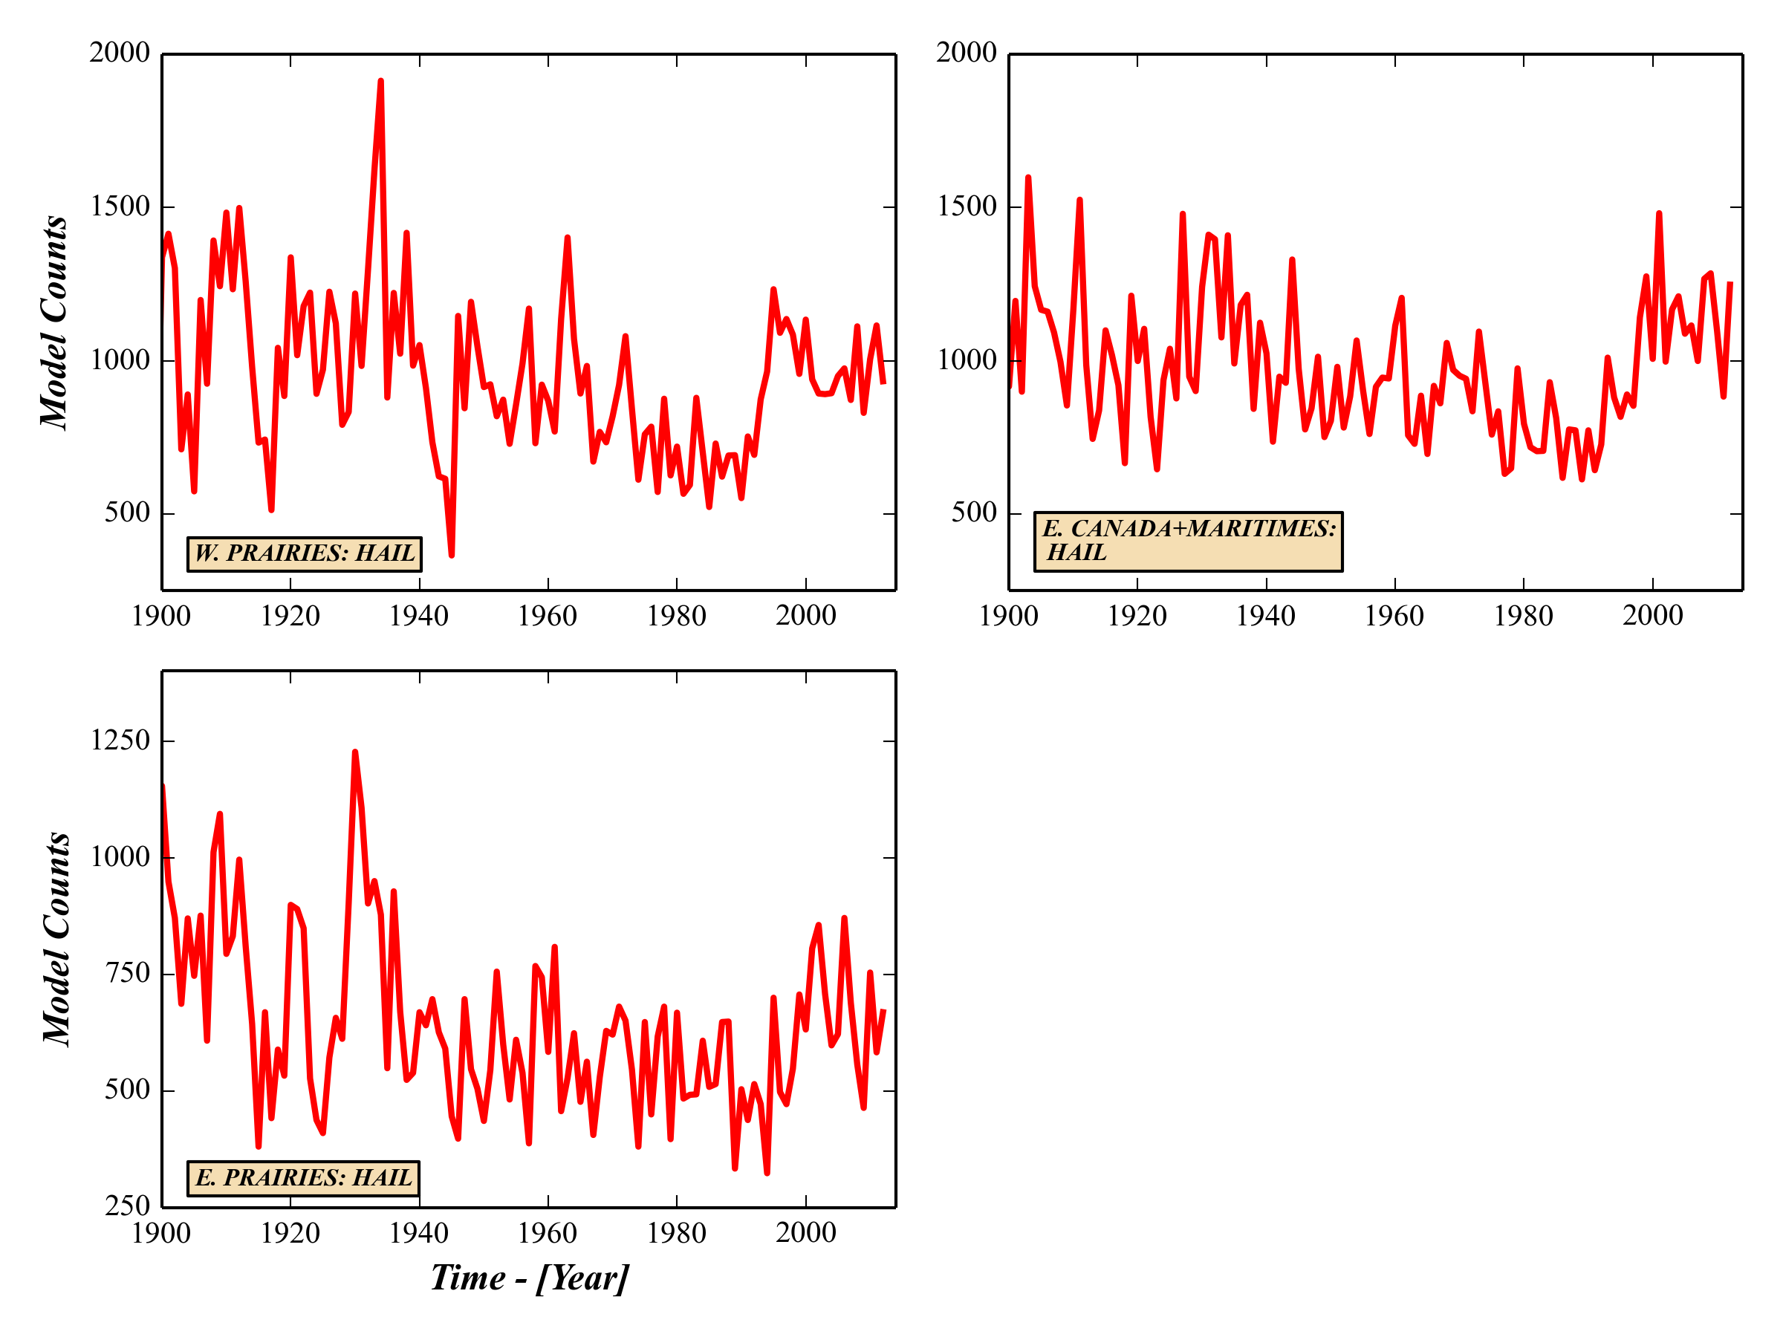
Long-term regional diagnosis severe hail environments, Canada

Slide 43
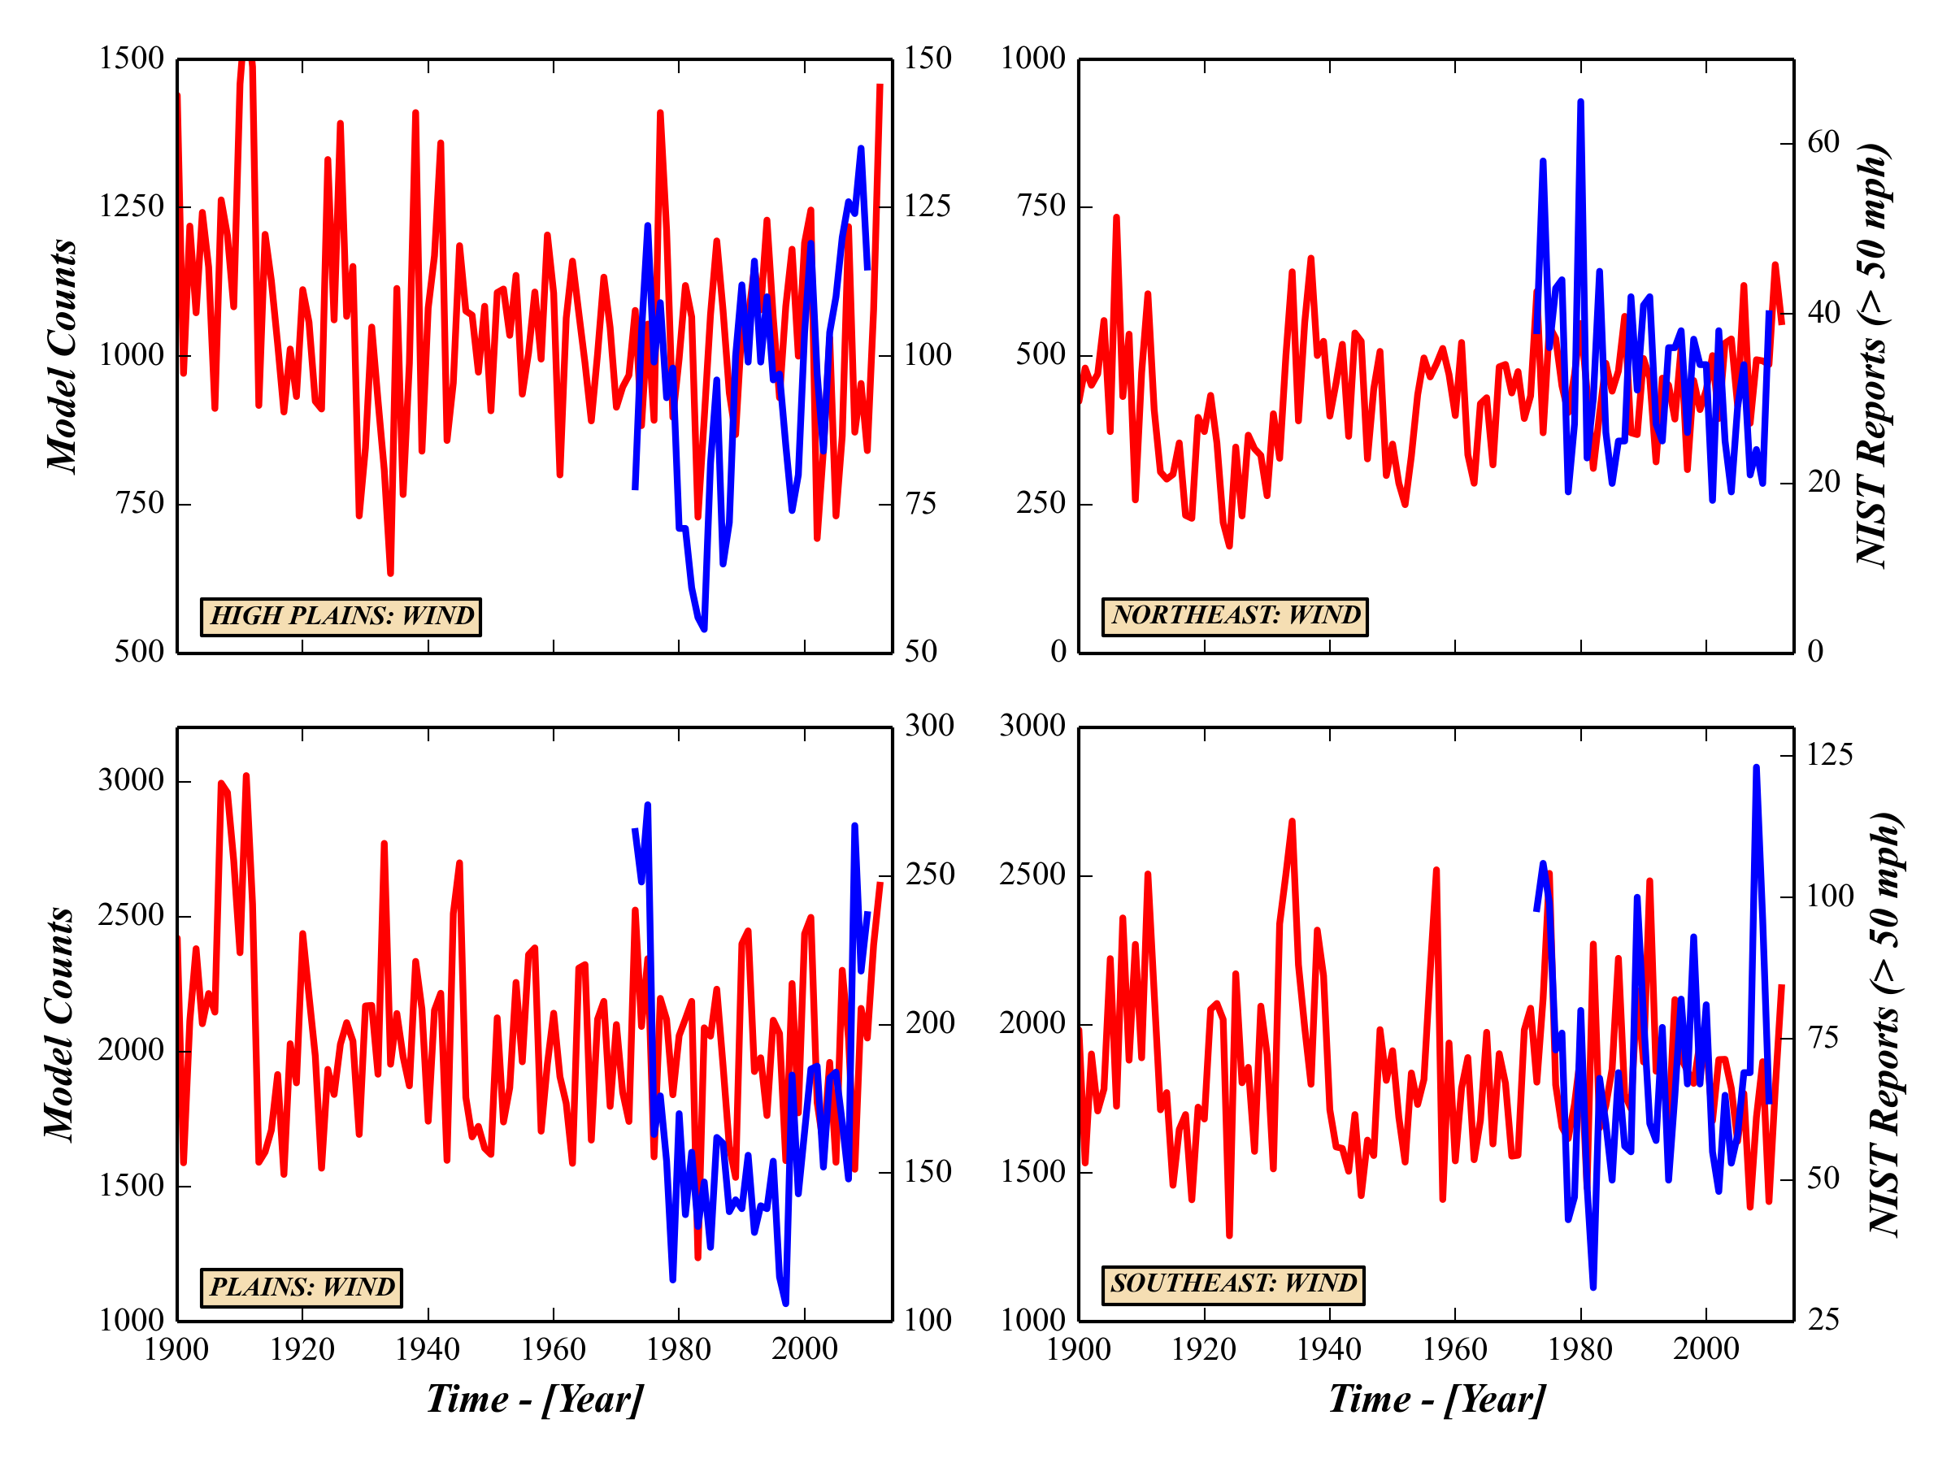
Long-term regional diagnosis severe wind environments, US

Slide 44
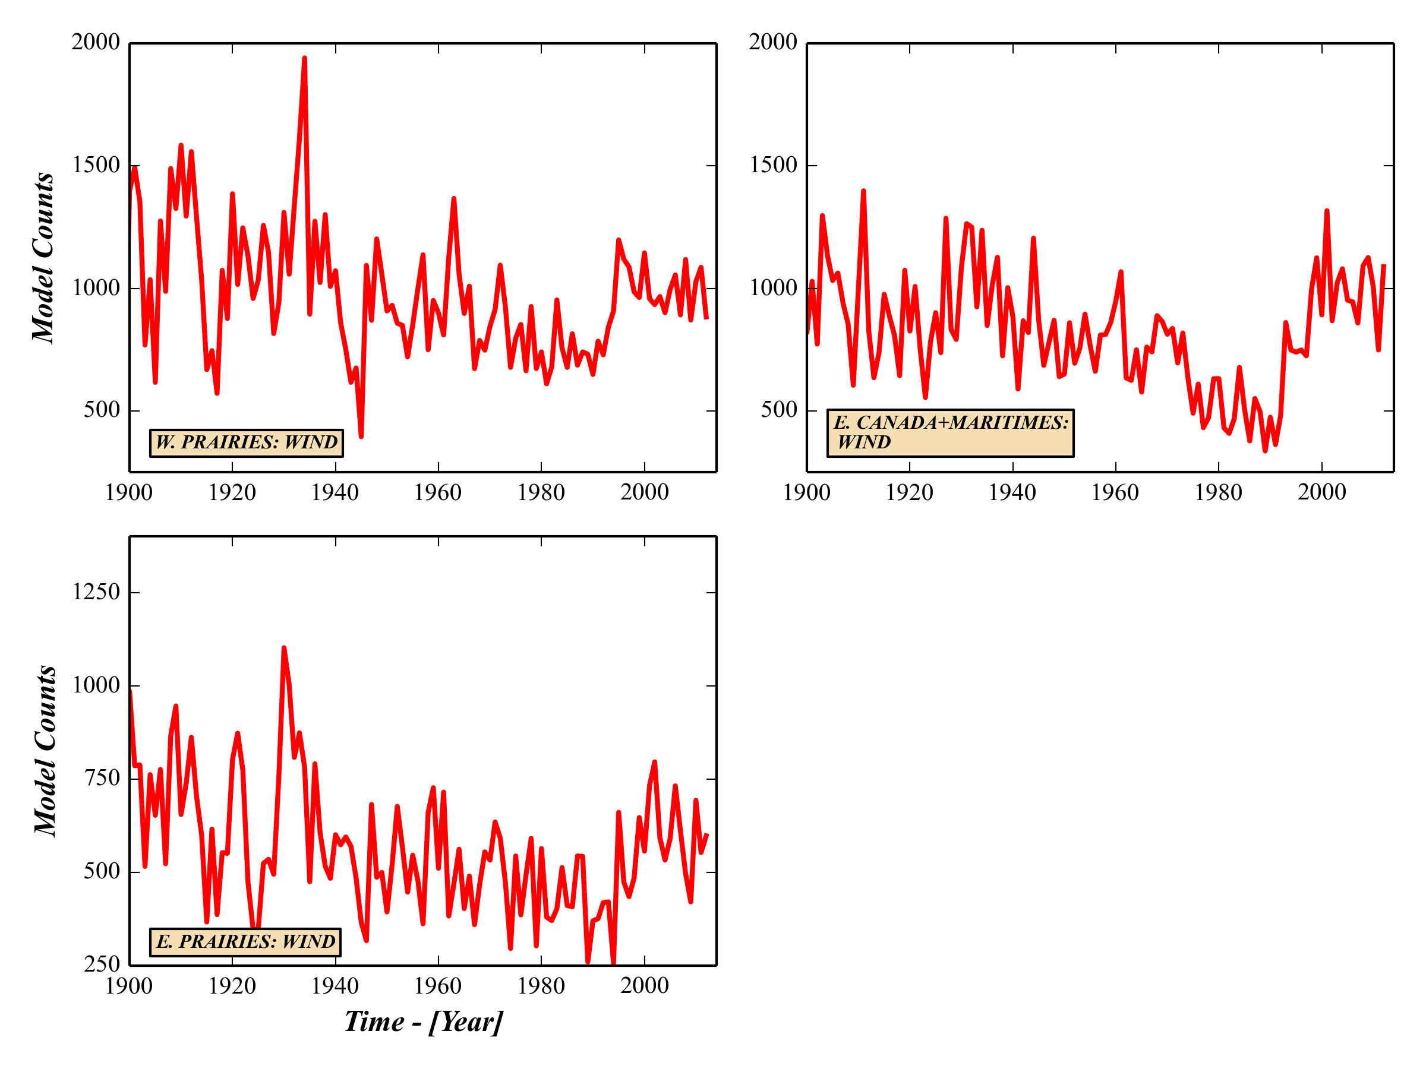
Long-term regional diagnosis severe wind environments, Canada

