Slide 1
ERRP Severe Wx Trends Literature Review - Slides
Jason C Furtado
AER Inc.
Updated: 13 June 2013

Slide 2
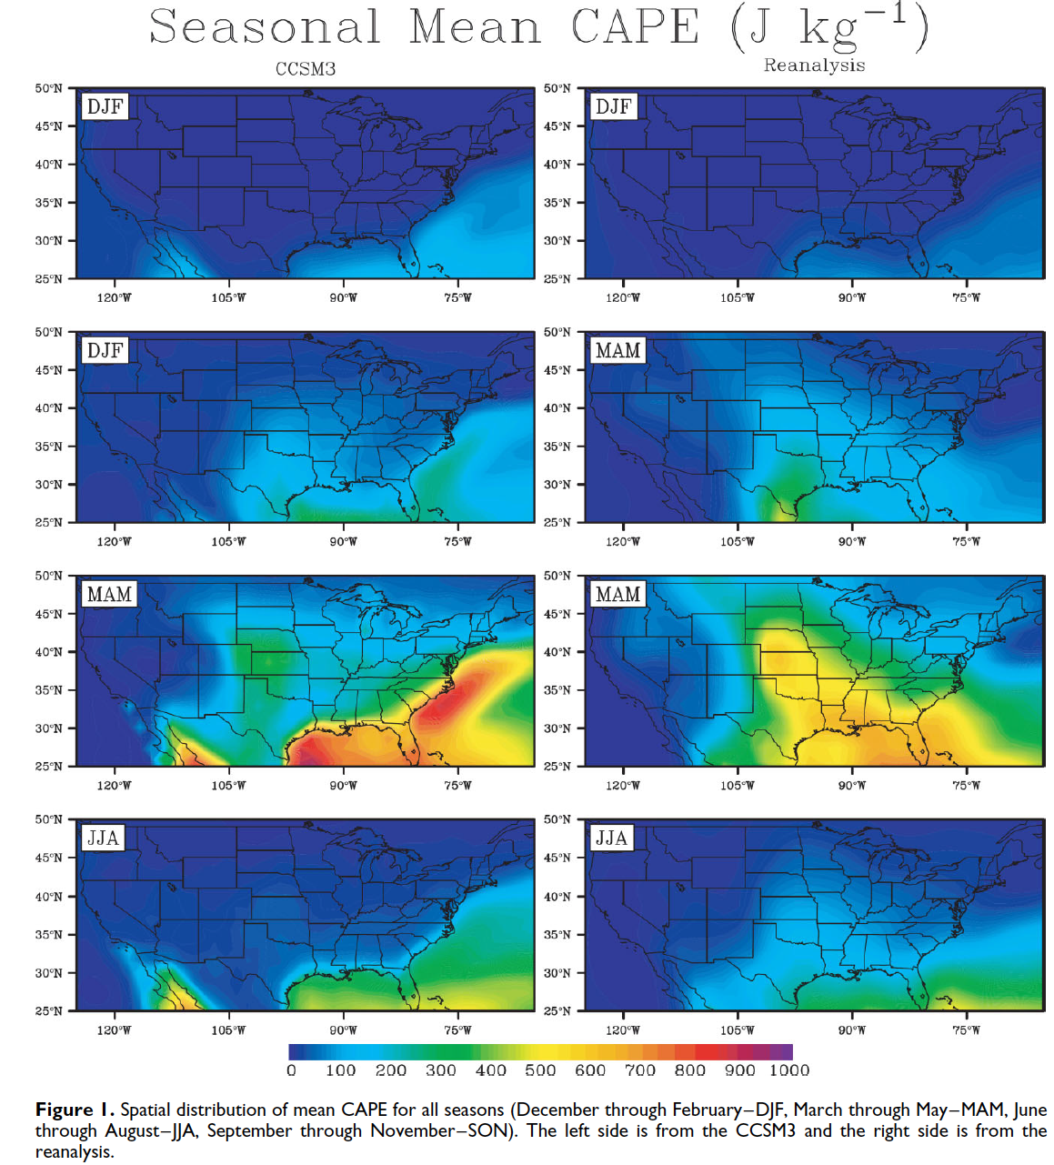
Marsh et al. (2007) – Assessing N. America Severe Weather in the CCSM3
There are notable differences in the structure of the climatological
CAPE between the model and obs.
---------------------------------------------------------------------------------------
(a) In general, simulated CAPE values over land are weaker than in
observations.
(b) The spring CAPE max in the model is over the Gulf Stream and
in the Gulf of Mexico. In observations, the spring max is the Gulf
Coast stretching northwestward into the Great Plains.
(c) The structure of the spring Great Plains maximum in the model
Is different in that it extends from the Central Plains down into
West Texas, not connecting into the Gulf.
Implications:
(a) Given the maxima over the Gulf Stream and Gulf Coast, the model tends to have its CAPE sensitive to moisture fluxes. This could be important for understanding model biases.
(b) How do we assess the ‘accuracy’ of future changes projected from the model if the fundamental structure is incorrect?
Marsh, P. T., H. E. Brooks, and D. J. Karoly, 2007: Assessment of the severe weather environment in North America simulated
by a global climate model. Atmos. Sci. Lett., 8, 100-106.

Slide 3
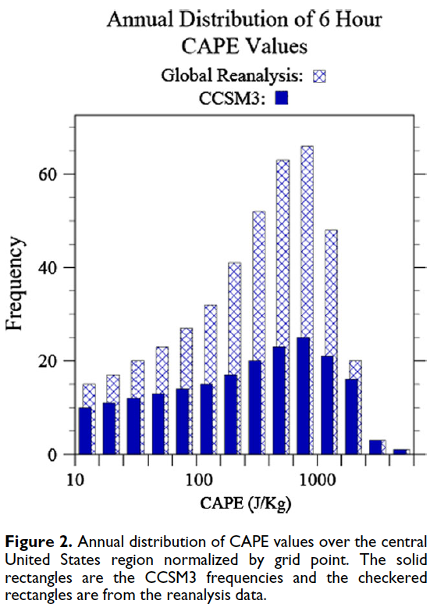
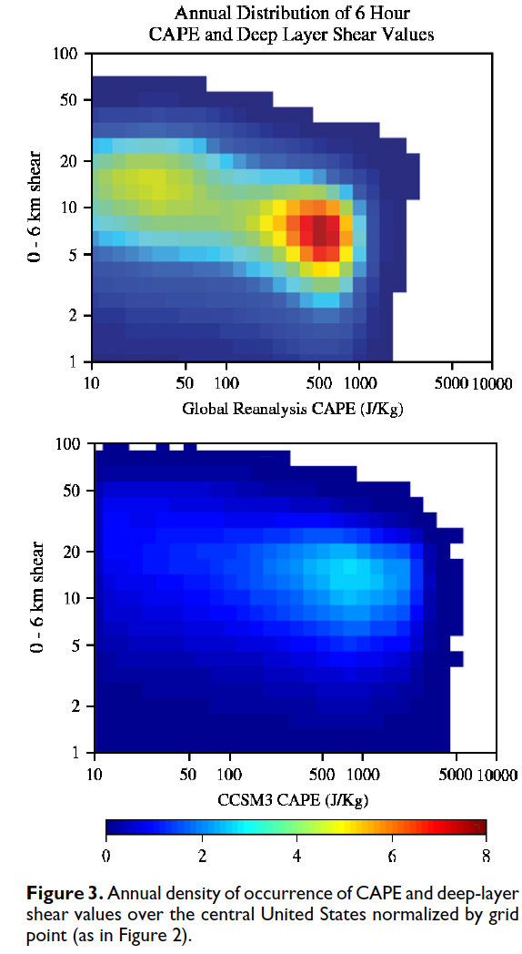
Marsh et al. (2007) – Assessing N. America Severe Weather in the CCSM3
The structure of the distribution looks similar, but the observations have a much more dramatic ramp up toward 1000 J/kg than CCSM4. But both of them do show the rarity in very high CAPE values.
Model and observed profiles have structural similarities, but the model fails to capture the secondary frequency max for low CAPE/high shear environments.

Slide 4
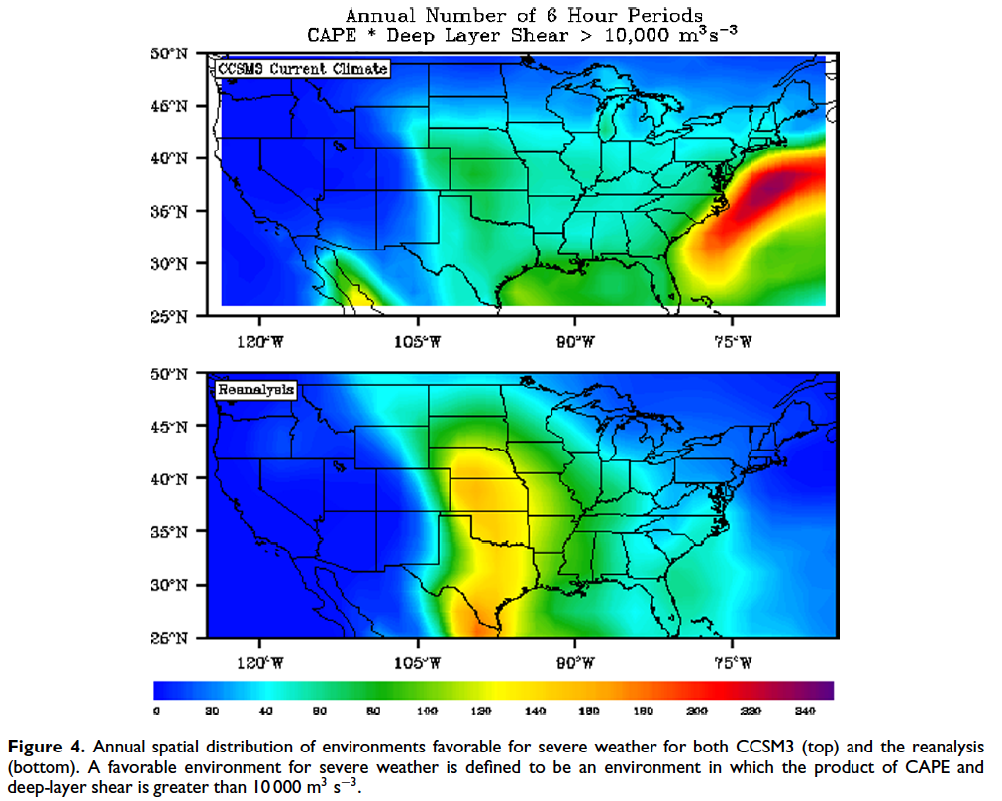
Marsh et al. (2007) – Assessing N. America Severe Weather in the CCSM3
The differences between the model and observations are:
-------------------------------------------------------------------------
The model overestimates the severe weather likelihood off of the Eastern Seaboard and underestimates the frequency in the Great Plains.
The model exhibits far less severe weather frequency over the Northern Plains and parts of the Midwest than is observed.
The model overestimates the severe weather frequency in the Northeastern US, particularly over New England.
Do these differences preclude us from using the CCSM3 (or other climate models) to make projections about future changes in severe weather based on increased GHGs?

Slide 5
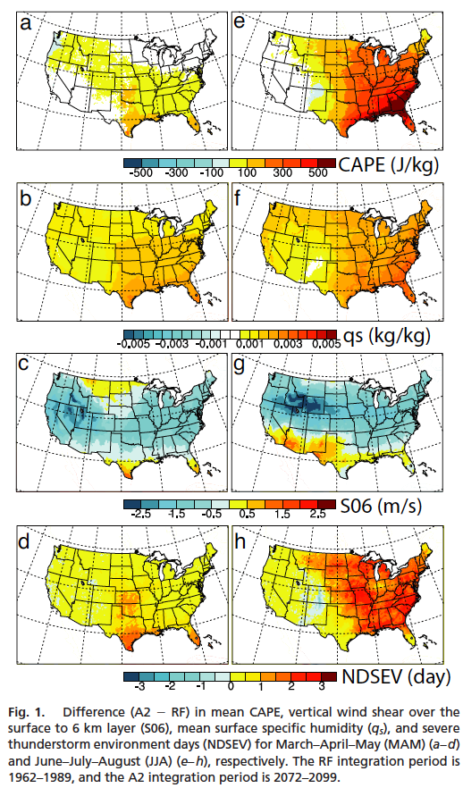
Trapp et al. (2007) – Changes in Severe T’Storm Frequency under Climate Change
NDSEV = (CAPE)*(S06) (from Brooks et al. 2003)
NDSEV > 10000 → NDSEV = 1 (severe wx likely)
Otherwise, NDSEV = 0 (severe wx unlikely)
Figure 1 indicates the changes in severe wx parameters under global climate change for spring (left) and summer (right). (1) CAPE will increase, especially across the East; (2) Total moisture will increase (warmer air, more water vapor); (3) Overall decrease in vertical shear (S06), likely due to a weakening and poleward contraction of the jet stream; but (4) NDSEV days actually go up across much of the nation, meaning CAPE increases overcome the changes in S06.
Trapp, R. J., N. S. Diffengaugh, H. E. Brooks, M. E. Baldwin, E. D. Robinson, and J. S. Pal, 2007:
Changes in severe thunderstorm environment frequency during the 21st century caused by
Anthropogenically enhanced global radiative forcing. Proc. Nat. Acad. Sci., 104, 19719-19723.

Slide 6
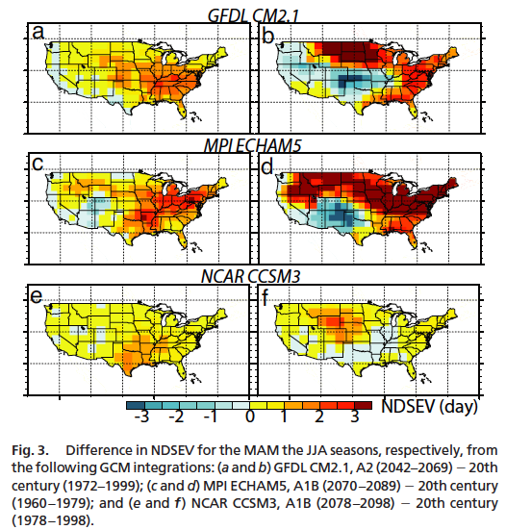
Trapp et al. (2007) – Changes in Severe T’Storm Frequency under Climate Change
Figure 3 highlights the expected changes in NDSEV from 3 models for the spring (MAM) and summer (JJA). For MAM, the models are in pretty good agreement with the pattern (CCSM4 is less aggressive for E US changes). For JJA. the most striking difference is the decrease in NDSEV expected in the S Central Plains (becomes very warm but also dry). This may be a problem with moist dynamics and/or land-surface interactions in the models.

Slide 7
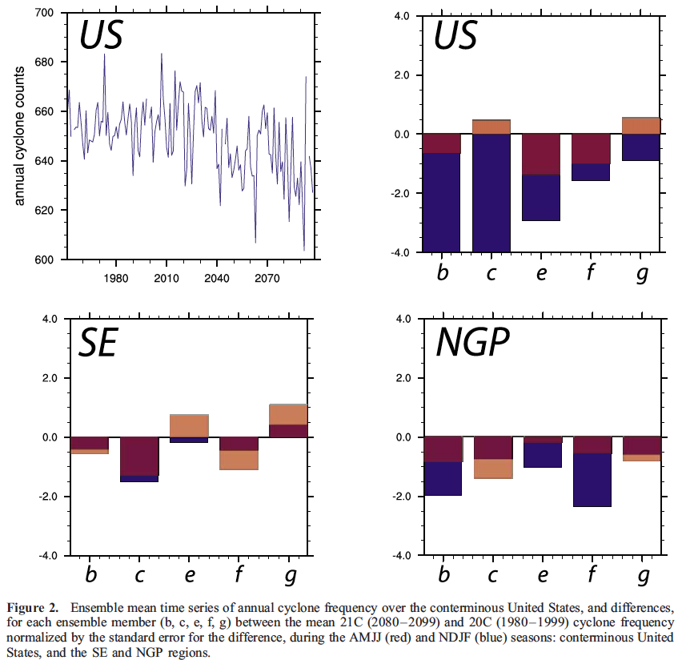
Trapp et al. (2009) – Transient Changes in Severe Wx under Future Climate Change
This paper produces the same conclusions as Trapp et al. (2007). But the paper takes a more ‘regional’ approach and also examines other causes, such as cyclone frequency (Figure 2).
Figure 2 shows that the overall frequency of cyclones is expected to decrease across the US. However, this decrease is primarily dominated in the cold season (blue bars in the other panels). During the spring, trends in cyclone frequency are statistically insignificant.
Trapp, R. J., N. S. Diffengaugh, and A. Gluhovsky, 2009: Transient response of severe thunderstorm
forcing to elevated greenhouse gas concentrations. Geophys. Res. Lett., 36, L01703,
doi:10.1029/2008GL036203.

Slide 8
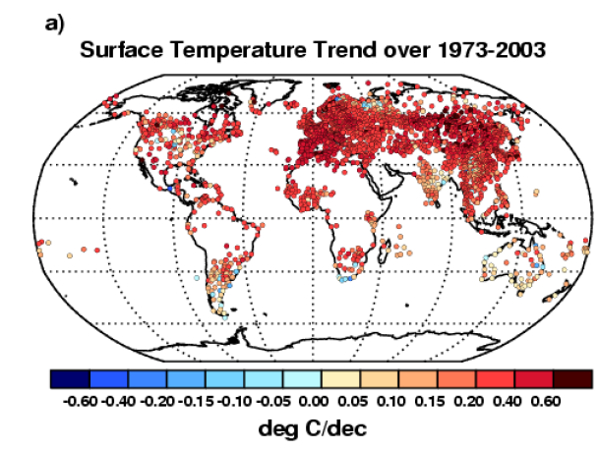
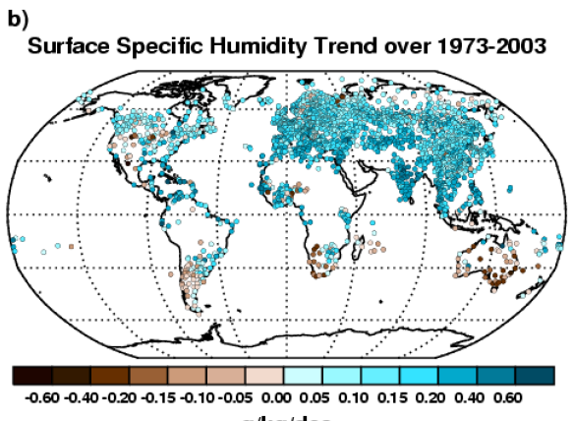
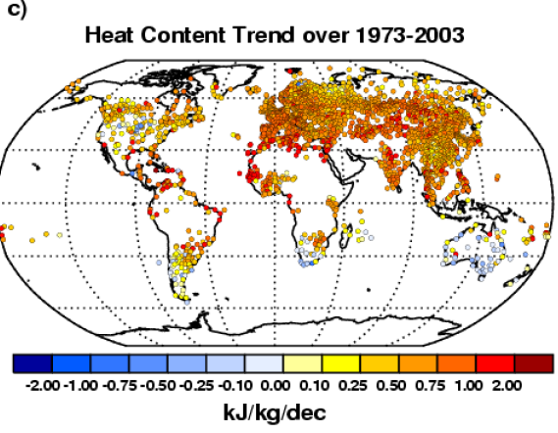
Peterson et al. (2011) – Observed Changes in Surface Energy over Land
Heat content (includes moisture) has increased over much of the globe with some areas of decrease (e.g., Australia).
Trends in Various Quantities:
Specific Humidity over Land: 0.11 g/kg/decade
Land surface temperature: 0.291 K/decade
Ocean surface temperature: 0.125 K/decade
Upper ocean heat content: 3.7e20 J/decade
Latent heat: 270 J/decade
Enthalpy: 300 J/decade
Kinetic Energy: -0.63 J/decade
FIGURE 1
Peterson, T. C., K. M. Willett, and P. W. Thorne, 2011: Observed changes in surface atmospheric
energy over land. Geophys. Res. Lett., 38, L16707, doi:10.1029/2011GL048442.

Slide 9
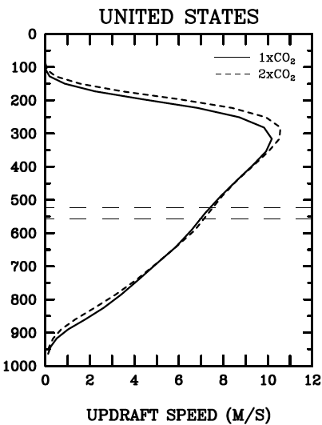
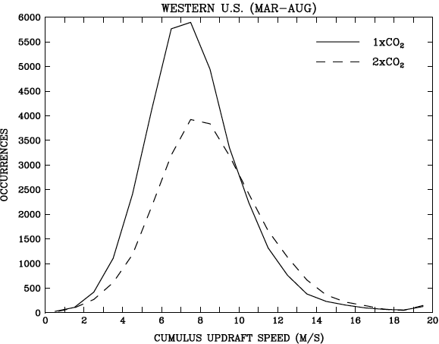
Del Genio et al. (2007) – More Moist Convection in a Future Warmer World
Updraft speeds
at the freezing
level.
Figure 3
Figure 2
Shift in the mean and in variance, but there is
overall less occurrence of updraft speeds >
7 m/s in the warmer world.
However, frequency of high (> 10 m/s) increases
in a warmer world (26% higher).
Empirically, this also means a higher frequency
of wildfires from more lightning strikes.
Freezing level rises by ~30 mb.
The higher freezing levels also assist
further acceleration of buoyant parcels
in the mid-troposphere.
Warmer climate updraft speeds
increase by ~1 m/s.
Del Genio, A. D., M.-S. Yao, and J. Jonas, 2007: Will moist convection be stronger in a
warmer climate? Geophys. Res. Lett., 34, L16703, DOIL10.1029/2007GL030525.

Slide 10
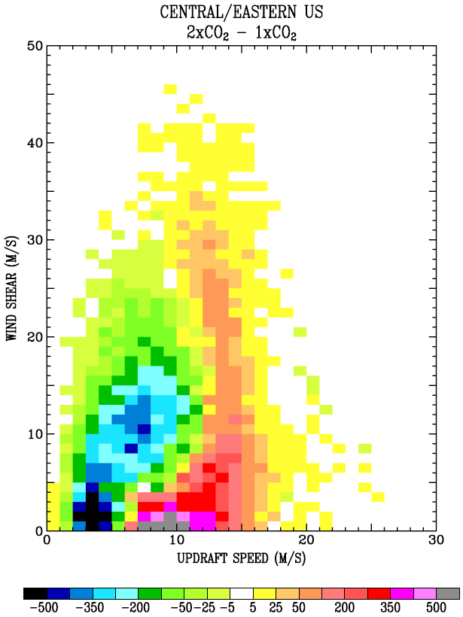
Del Genio et al. (2007) – More Moist Convection in a Future Warmer World
Decrease in the low-end wind shear/updraft speed occurrences. This indicates perhaps a decrease in the total number of severe weather events.
However, there is an increase in the ‘high-end’ (high updraft / high shear’), probably from the increase in CAPE.
- Hence, there could be more intense storms (locally).
Figure 4

Slide 11
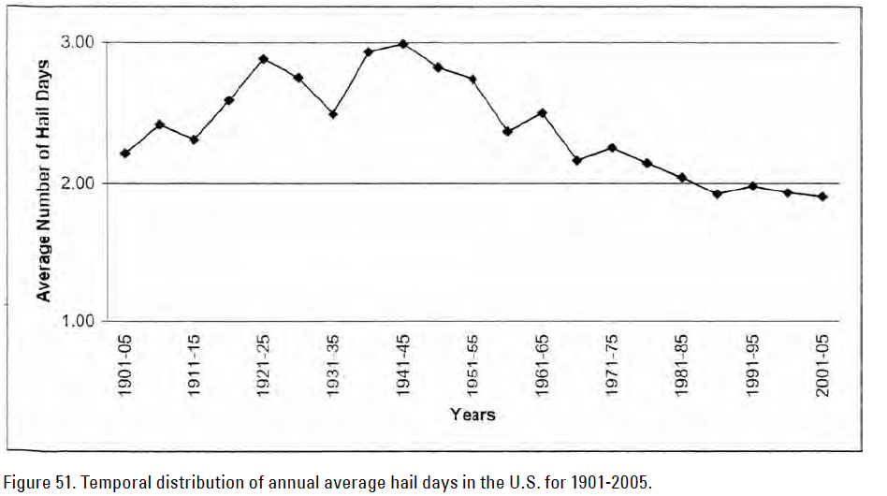
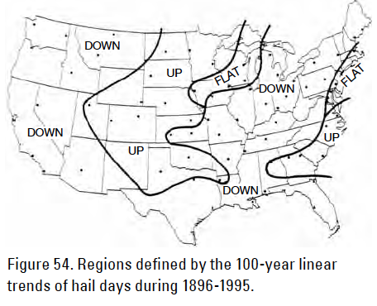
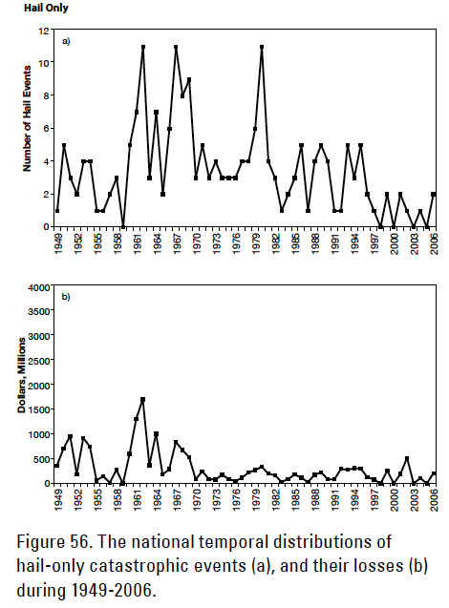
Changnon et al. (2009) – Hailstorms Across the Nation
Observed overall decline in number of hail days. Real or changes in observing practices?
The downward trend seen nationally is non-uniform. There are ‘up’ trends in hail in the favored areas (i.e., Great Plains and Western High Plains) and also along the SE Coast.
We also see a flat trend in reported hail losses (with some interannual variability).
Changnon, S. A., D. Changnon, and S. D. Hilberg, 2009: Hailstorms Across the Nation: An
Atlas about Hail and its Damages. Published by the Midwestern Regional Climate Center. 92 pp.

Slide 12
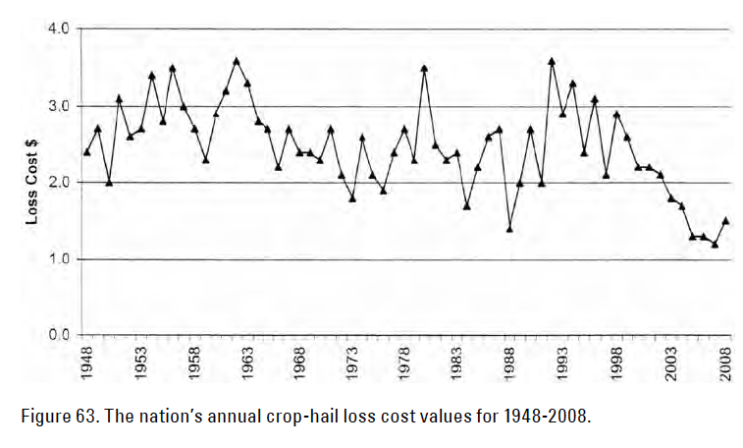
Changnon et al. (2009) – Hailstorms Across the Nation
The authors have noted the following about linear trends in crop-hail loss:
States in the High Plains and mountains (except for Kansas) had flat trends;
Midwestern states, including Kentucky and Tennessee, had downward trends; and
Southeastern states had upward trends.
There is variability seen in the crop-hail loss across the nations. There are high values in the 1950s and early 1960s, then a low period during the 1970s, a spike in 1980, low values again and then a big spike in the 1990s (1993 as the max). Since, there has been a sharp downturn.

Slide 13
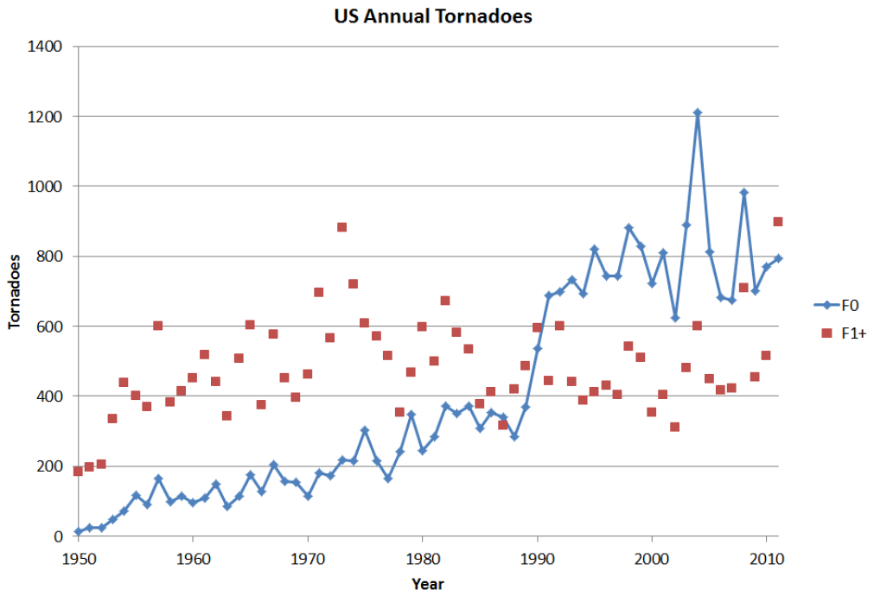
Kunkel et al. (2013) – Trends in Extreme Weather
The trend is up for weak (F0) tornadoes, but F1+ tornadoes has high variance and perhaps no trend.
Conclusions on changes in severe storms are that:
The data are fraught with inconsistencies.
Though background conditions may grow more
favorable in the future, the recent past has so
much interannual variance that trends become
statistically insignificant.
(3) Best statistical (and physical) links to severe vs. non
severe storms is comparing shear to max updraft (high
shear/moderate-high Wmax yields better chance of
tornadoes.
Kunkel, K. E., and Coauthors, 2013: Monitoring and understanding trends in extreme storms:
State of knowledge. Bull. Amer. Meteor. Soc., 94, 499-514.

Slide 14
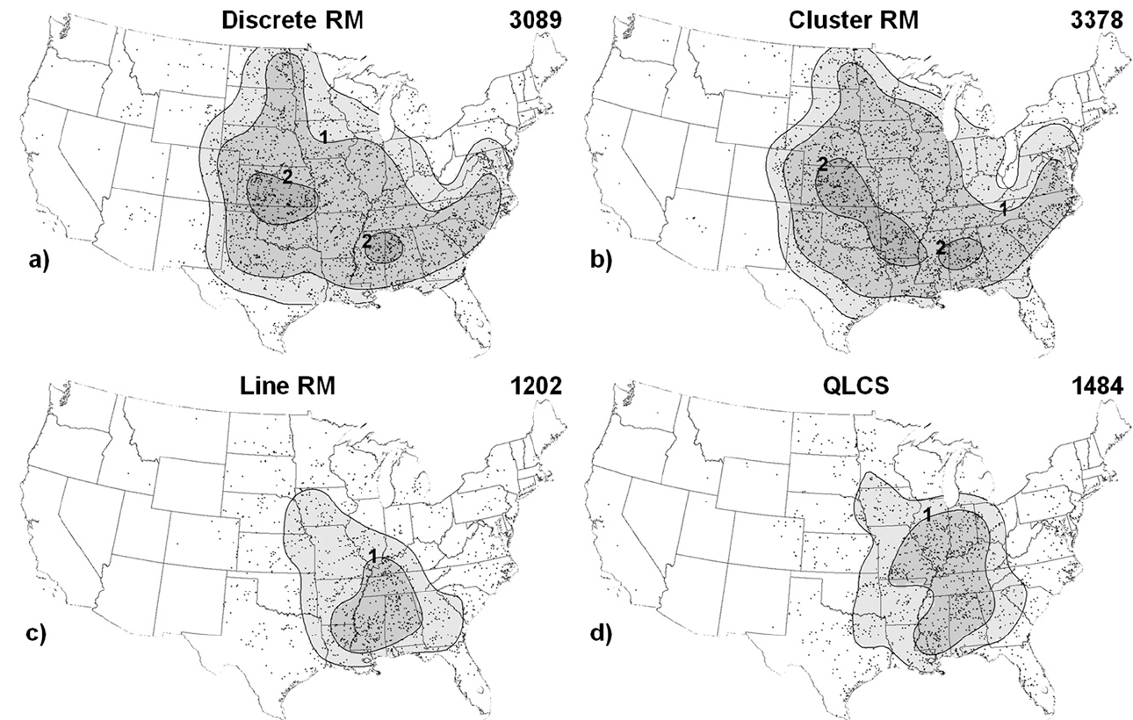
Smith et al. (2012) – Convective Mode Climatology in the U.S.
Most of the Central
Plains tornadoes are
from right-moving
supercells.
Lines dominate primarily
in the Midwest and parts of the SE.
Binning tornado events by the type of storm.
Smith, B. T., R. L. Thompson, J. S. Grams, C. Broyles, and H. E. Brooks, 2012: Convective modes for significant severe thunderstorms in the Contiguous United States. Part I: Storm classification and climatology. Wea. Forecasting., 27, 1114-1135.

Slide 15
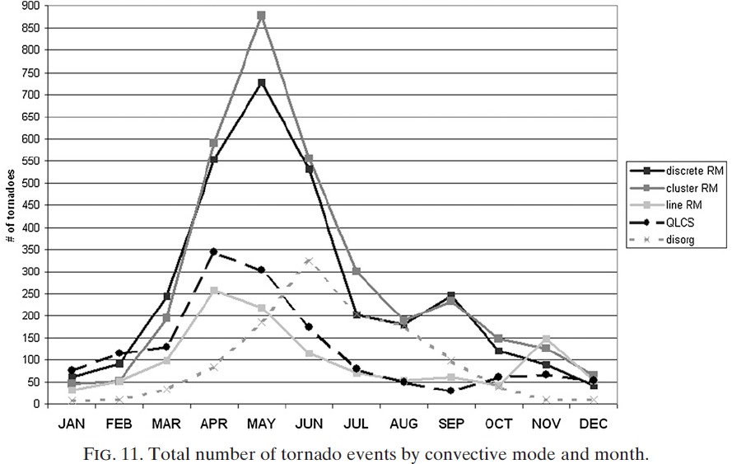
Smith et al. (2012) – Convective Mode Climatology in the U.S.
Discrete and cluster RM dominate spring.
Sea breeze events?
QLCS tornadoes peak
Secondary peak from tropical cyclones in Sept.

Slide 16
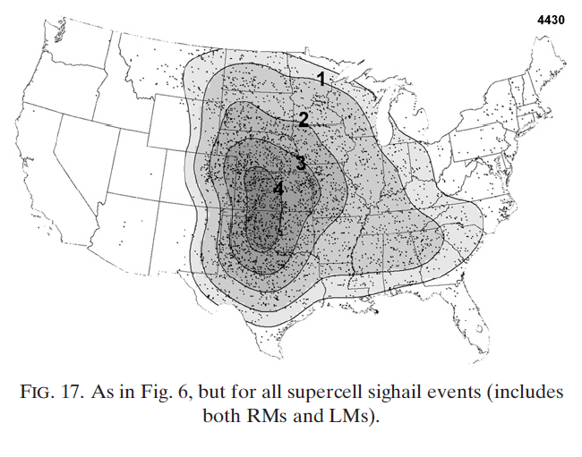
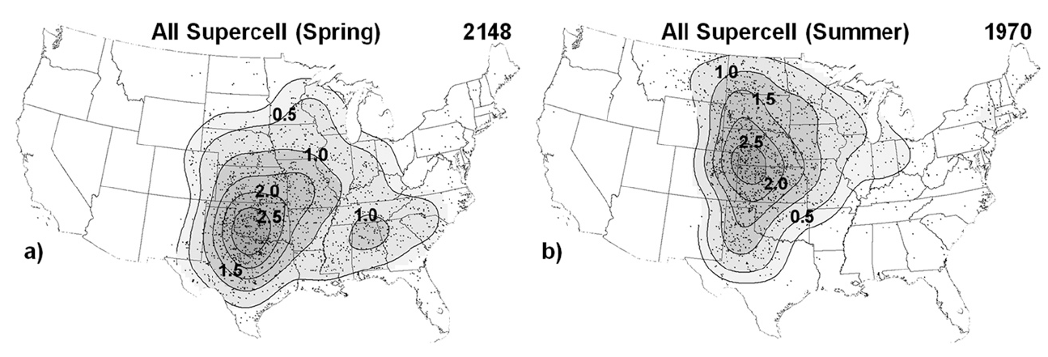
Smith et al. (2012) – Convective Mode Climatology in the U.S.
SIGNIFICANT HAIL EVENTS

Slide 17
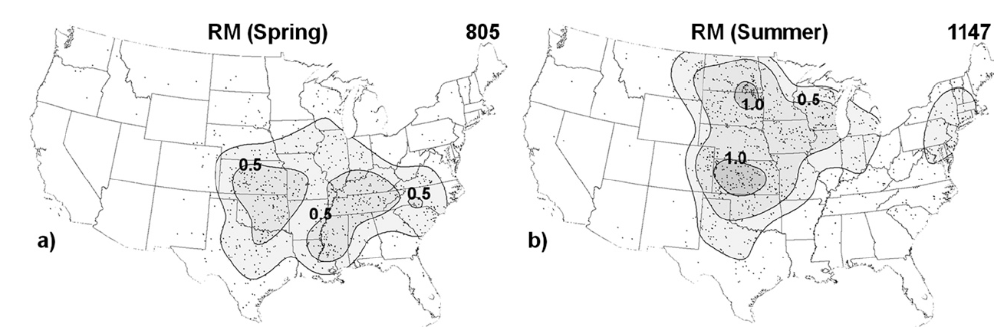
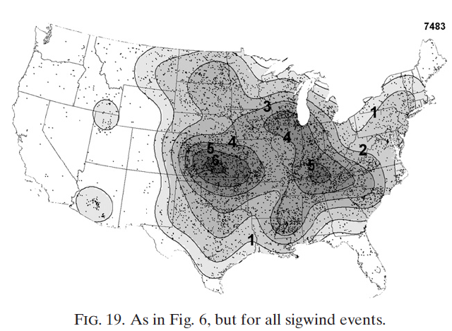
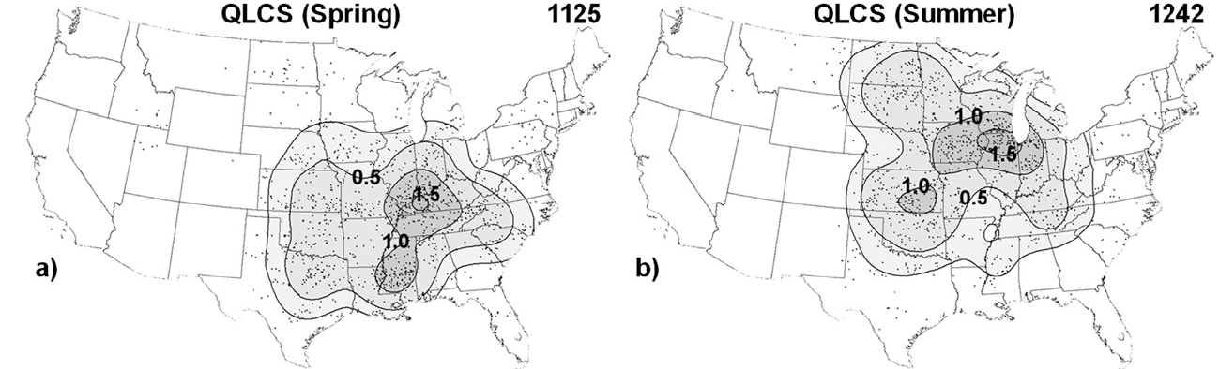
Smith et al. (2012) – Convective Mode Climatology in the U.S.
SIGNIFICANT WIND EVENTS
Climatology is split between convective type and the region of interest.

Slide 18
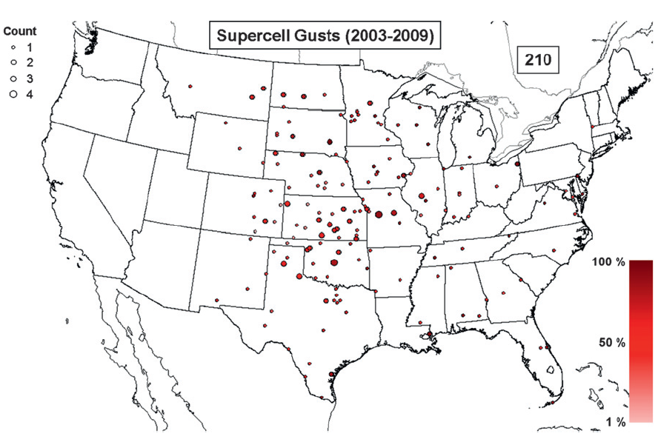
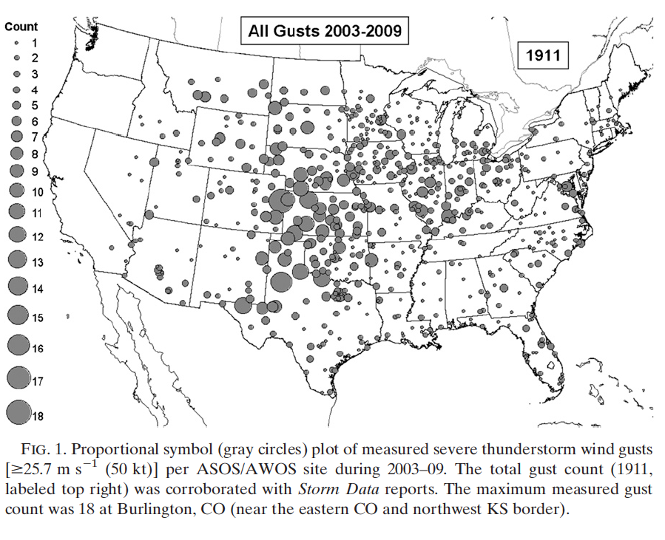
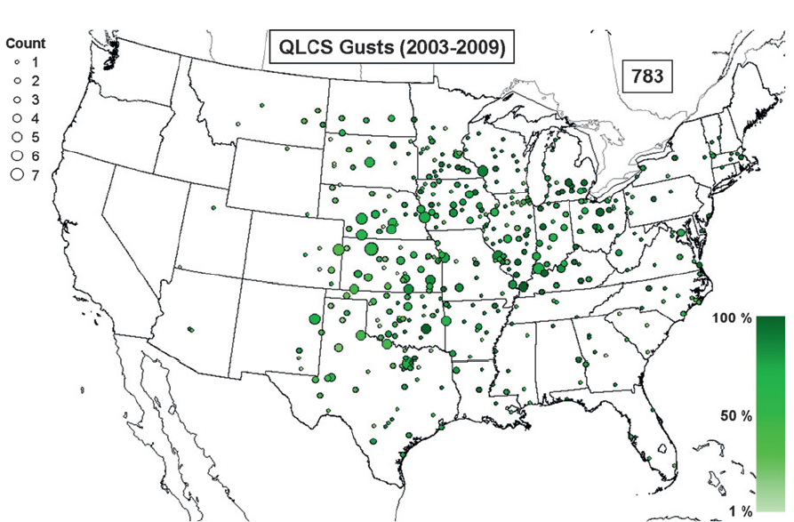
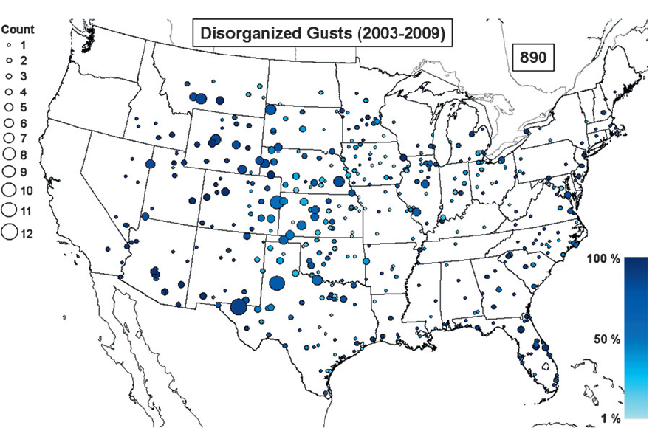
Smith et al. (2013) – Severe Convective Wind Climatology in the U.S.
Supercell type
dominant in Cen. Plains.
QLCS more widespread but dominates
Midwest severe wind events.
Nota bene: There are significant discrepancies
in the two datasets explored in this study (Fig. 6
of the paper).
Rockies and W. High Plains max.
Smith, B. T., T. E. Castellanos, A. C. Winters, C. M. Mead, A. R. Dean, and R. L. Thomspon, 2013: Measured
severe wind climatology and associated convective modes of thunderstorms in the contiguous United States,
2003-09. Wea. Forecasting, 28, 229-236.

Slide 19
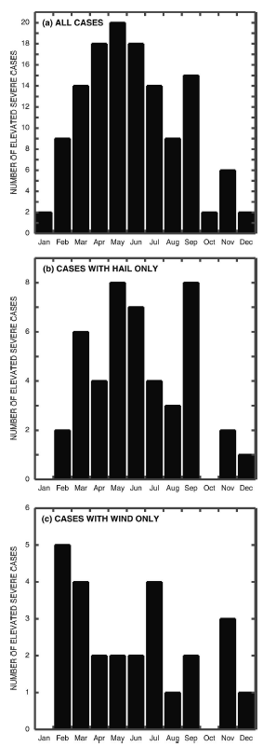
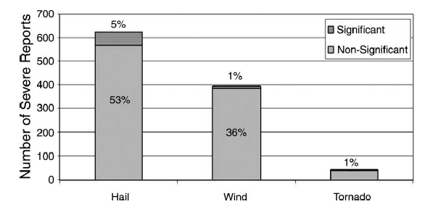
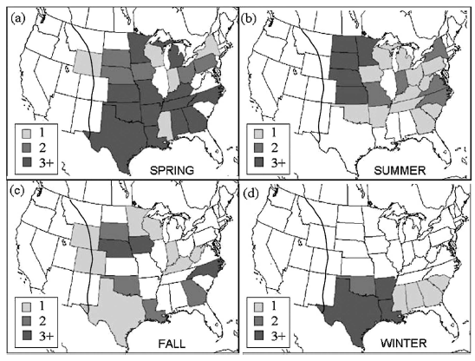
Horgan et al. (2007) – Elevated Severe Convective Storms
Elevated storm climatology from 1983-87.
Max elevated storms occur in the spring-early summer. Secondary max in September.
Elevated storms primarily cause hail and wind.
Great Plains dominate in the spring and summer.
Hail max in May and September.
S. Plains max in winter.
Wind cases peak in February.
Horgan, K. L., D. M. Schultz, J. E. Hale, Jr., S. F. Corfidi, and R. H. Johns, 2007: A five-year
climatology of elevated severe convective storms in the United States east of the Rocky Mountains.
Wea. Forecasting, 22, 1031-1044.

Slide 20
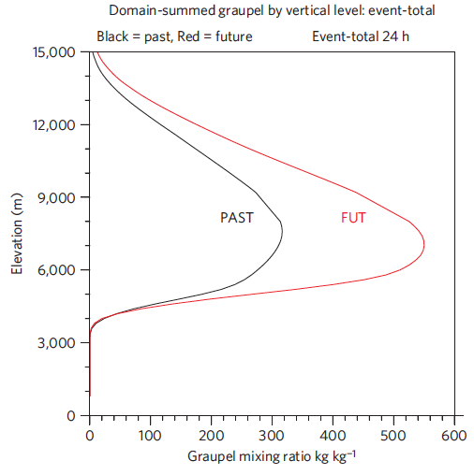
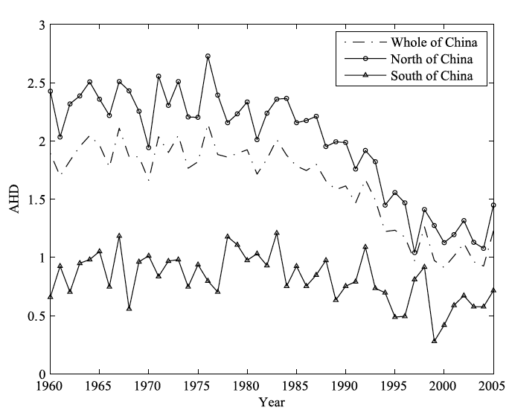
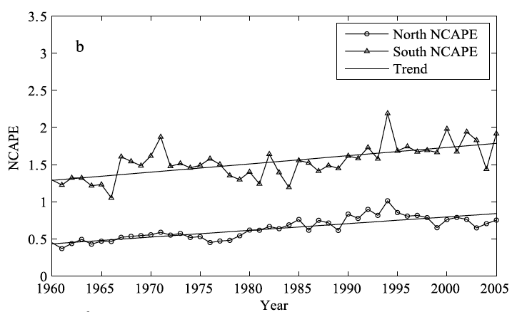
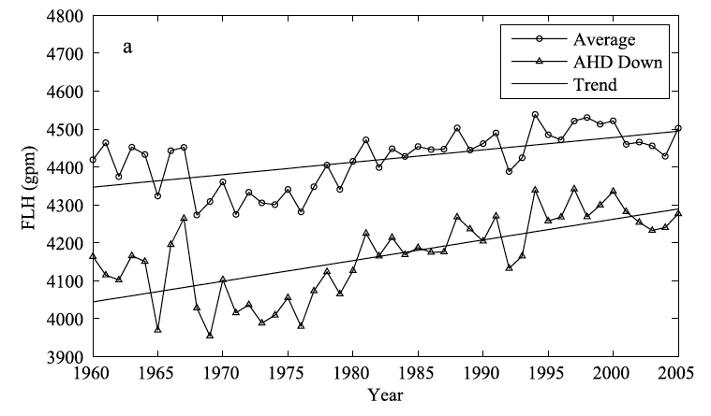
Trends and Projected Changes in Hail (Xie et al., 2008; Mahoney et al. 2012)
Mahoney et al. (2012) model changes in hail over the Rockies.
-- Competing hypotheses for future hail.
(a) Warmer, moister climate favors more vigorous T’storms, more hail.
(b) Warmer climate causes lifting of the freezing level, making it
difficult to grow hailstones and then also increasing melting layer.
-- Regional modeling supports hypothesis (b).
Xie et al. (2008) find similar findings in observations of hail data over China.
They find that total number of hail days are decreasing in China, despite
increasing CAPE. The common link is a lifting of the freezing level.
Narrowing of the distribution negates the overall larger amounts. [Mahoney et al. 2012]
Slight increase in CAPE.
Decreasing trend in hail days, esp. N China.
Rising freezing levels.
Mahoney, K., M. A. Alexander, G. Thompson, J. J. Barsugli, and J. D. Scott, 2012: Changes in hail and flood risk in high-resolution simulations over Colorado’s mountains. Nat. Clim. Change, 2, doi:10.1038/NCLIMATE1344.
Xie, B., Q. Zhang, and Y. Wang, 2008: Trends in hail in China during 1960-2005. Geophys. Res. Lett., 35, L13801, doi:10.1029/2008GL034067.

Slide 21
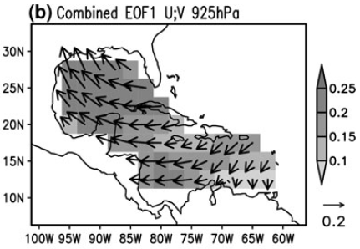
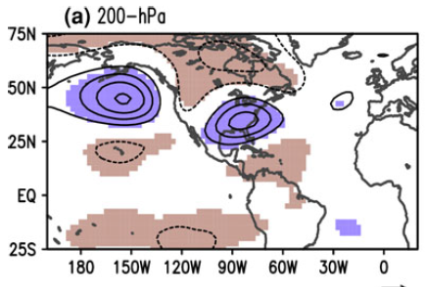
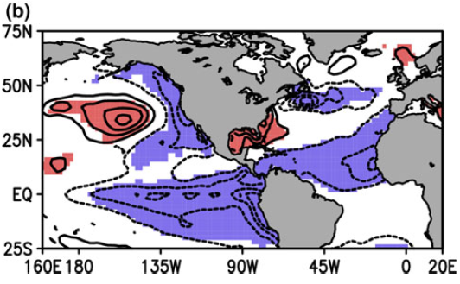
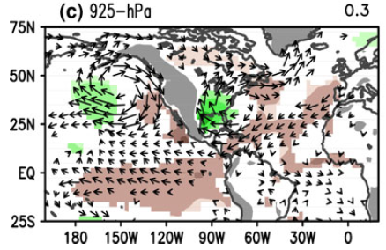
Muñoz and Enfield (2011) – Linking LLJ Variability to Large-Scale Climate Modes
+
-
+
-
LLJ in the Great Plains tied to IAS jet from Caribbean and Gulf of Mexico.
Regressions on global SSTs show connections to the PDO and ENSO, as well as a dipole in SSTs between the Gulf of Mexico and the Caribbean Sea. Not much of a connection outside of the tropical Atlantic.
Regressions on the IAS jet index shows strong moisture flux into the Plains at low levels. On the large scale, the index is related to the negative phase in the PNA pattern.
Muñoz, E. and D. Enfield, 2011: The boreal spring variability of the Intra-America low-level jet and its relation with precipitation and tornadoes in the eastern United States. Clim. Dyn., 36, 247-259.

Slide 22
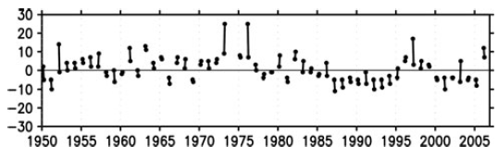
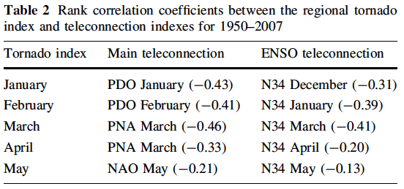
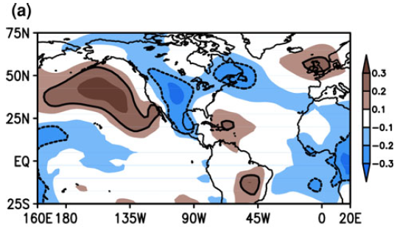
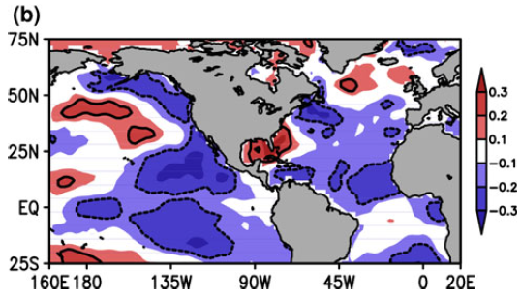
Muñoz and Enfield (2011) – Linking LLJ Variability to Large-Scale Climate Modes
Tornado Count Index (F2+)
The relationship between the tornado count and SLP/SST are similar to the correlations/teleconnections from, the LLJ. Since there is physical links between the strength of the LLJ and severe thunderstorms that form these tornadoes, monitoring high- and low-frequency variability in the LLJ could indicate changing trends in tornadoes/severe thunderstorms in the Central and Eastern US.
r (SLP, Tornado Index)
r (SST, Tornado Index)

Slide 23
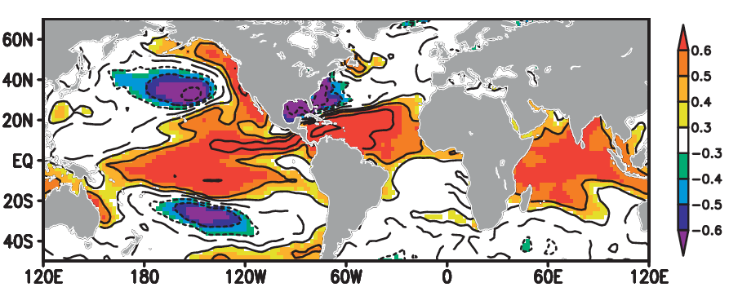
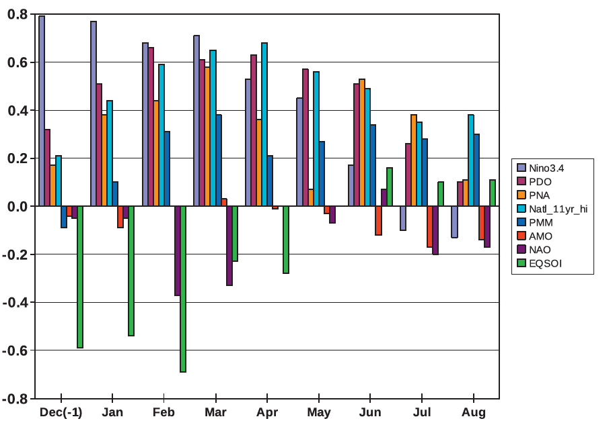
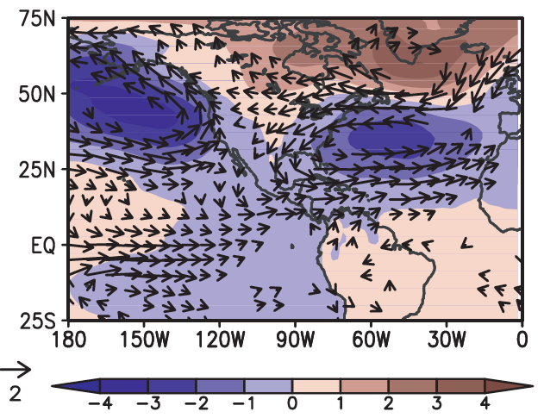
Muñoz et al. (2010) – Linking IAS SST Dipole to Large-Scale Climate Modes
IAS SSTA Index = CBN-GMX when sgn(CBN) = -sgn(GMX).
CBN = March standardized SSTa in the Caribbean
GMX = March standardized SSTa in the Gulf of Mexico
r(FMA SSTa, IAS)
Opposite signed from Muñoz et al.
(2011) treatment of the IAS.
PDO and ENSO signatures emerge.
Regression on low-level circulation shows some signatures of the NAO and also the PNA pattern in the Pacific.
Correlations with PNA, PDO, and NINO3.4 are the highest.
Muñoz, E. C. Wang, and D. Enfield, 2010: The Intra-Americans springtime sea surface temperature anomaly dipole as fingerprint of remote influences. J Climate., 23, 43-56.

Slide 24
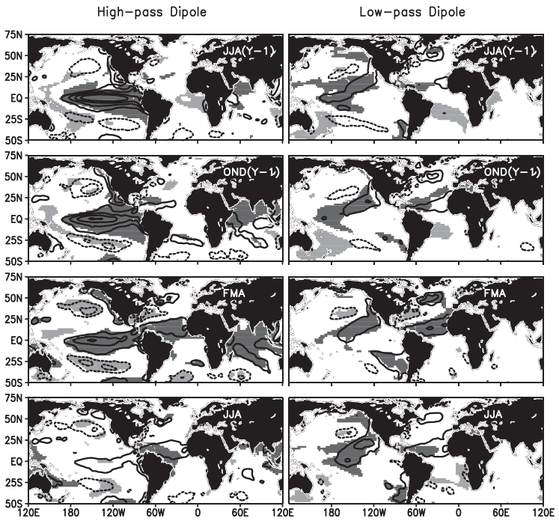
Muñoz et al. (2010) – Linking IAS SST Dipole to Large-Scale Climate Modes
< 5 years
> 5 years
ENSO and some PDO
influence seen in the
high-frequency
signal.
The Pacific Meridional
Mode signature (possibly
the North Pacific Gyre
Oscillation?)

Slide 25
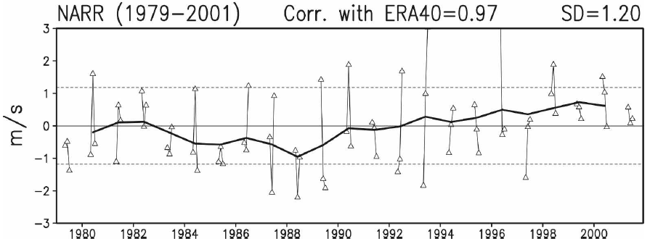
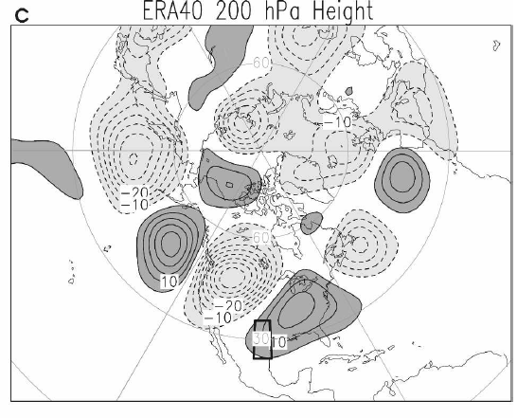

Weaver and Nigam (2008) – GP LLJ Variability: Influences and Impacts
GP LLJ Index Anomalies
Trend toward higher positive values
in 1990s and early 2000s…
Stronger S flow, more
moisture into Plains
Weaker S flow, less
moisture into Plains
Equivalent barotropic
structure
PNA Pattern
NAO?
Can be traced to the WPAC Warm Pool and convection.
Weaver, S. J., and S. Nigam, 2008: Variability in the Great Plains low-level jet: Large-scale circulation context and hydroclimate impacts. J Climate., 21, 1532-1551.

Slide 26

Gensini and Ashley (2011) – Climatology of Severe Weather Environments
Declining trend in severe wx environment but an increasing trend in severe wx reports and severe wx days.
The cause of the significant decline is primarily a decline is CAPE values over the US, which would inhibit severe wx formation.

Slide 27

Lee (2012) – Tornado Favorable Environments in Future Climate
Several observations from the coupled climate model output:
For the 3 scenarios and for both models, the forecast is for higher frequency in strong (F2+) tornado days in the future over much of the eastern Midwest and Mid-Atlantic.
The models also agree on the decrease in tornado days in the Southern and Northern Plains.
Models disagree on what will happen in the Central Plains – this perhaps may be a nodal point and hence difficult to assess.
Parts of the Southeast may see more F2+ tornado days under the ‘B1’ scenario (i.e., business as usual).
There is an overall neutral trend in the Northeast.

