Slide 1



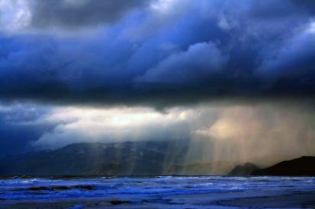
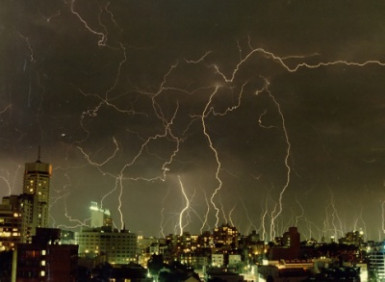
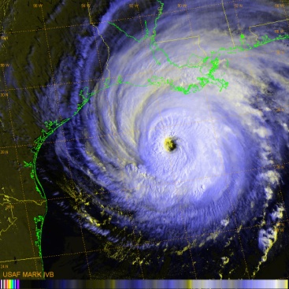
Emerging Risk Research Program
Executive Summary of Phase I Results
Diagnosis of Severe Weather
Environments in the US
June 23, 2014
Notes:
40 min of prepared content
“Increase my time serving the customer & make it easy for them”
“Reduce my indemnity through fraud detection and loss control”
“Reduce clock time to stabilize my bulk reserves”
“Reduce operational risk through codifying the process”

Slide 2
Emerging Risk Research Program
Climate Variation and Severe Convective Hazards
2-year effort, 2013-2015, to detect and quantify changes in the occurrence of hail/tornado/wind perils in the US and Canada
9 participating US and Canadian insurers
Phase 1/Year 1 is finished and looked at long-term, large-scale trends in hail/tornado/wind
Phase 2/Year 2 starts now and will explore differentiation of severe weather risk on small spatial & time scalesd

Slide 3
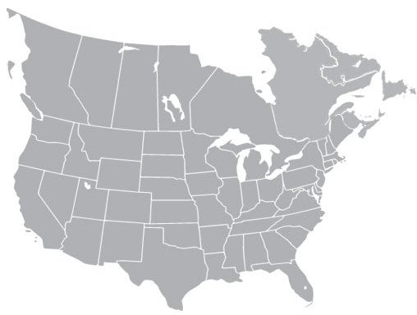
Summary of Broad Phase 1 Conclusions
Differences in severity (e.g., hail size, path width/length, etc.) that will be assessed in detail in Phase 2 may amplify or offset what has been observed in the broad environments over the last 20 years
Canada and NE US
✓ Increased #s of environments
✓ Increase in area of environments
= % magnitude depends on baseline
Central US: Complex Picture
✓ Decreased #s of environments
✓ Increase in area of environments
✓ Observations stable
✓ Implies not-Cat decrease; Cat increase
✓ Greater interannual variance. (#, timing)
✓ Step change in tornado width (reporting)
= Implies reallocation of risk and likely net increase
when considering variance
Southeast US
✓ Decreased # of environments
✓ Decrease. in area of environments
= % magnitude depends on baseline

Slide 4
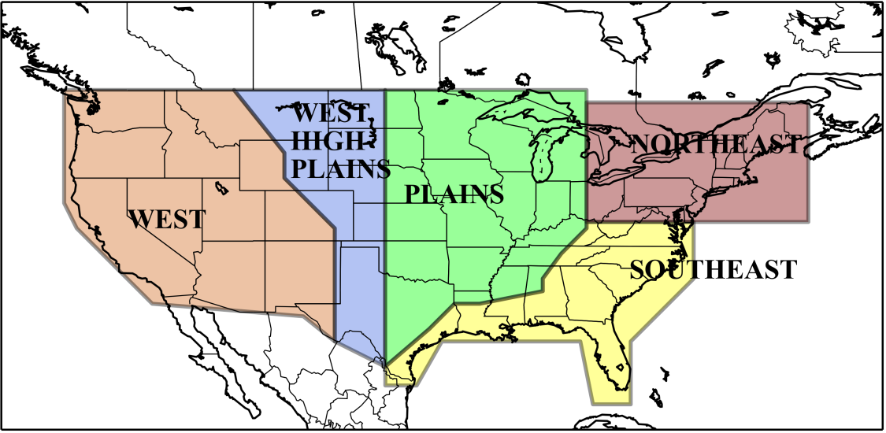
Multi-way Discrimination Modeling
We built new models that recognize hail-, tornado- and wind-producing conditions
They identify, i.e., discriminate, favorable/non-favorable atmospheric environment for severe weather from primary, physical drivers
Training period: 2000 – 2012
reconstruction of the climate + observations of severe weather = discriminant relationship
Application period: 1940 – 2012
15 Independent Peril Models
15 independent perils models
Region | Hail | Tornado | Wind
Plains | ✔ | ✔ | ✔
West High Plains | ✔ | ✔ | ✔
Southeast | ✔ | ✔ | ✔
Northeast | ✔ | ✔ | ✔
West | ✔ | ✔ | ✔

Slide 5
Long-term diagnosis: US and Canada 1940 - 2012
USA
These are 5-year running averages of annual environments – whole US/all of Canada:
little drift overall, but
yr-to-yr variance is ⬆ over the last 15-20 yrs.
CANADA
Canada is a very different story, including a marked increase in the 1990s.

Slide 6
Long-term regional diagnosis hail environments, US
West:
hail
environments
variable but not drifting.
High Plains:
hail
environments
variable but not drifting.
Plains:
hail
environments
steady.
Northeast:
hail
environments
⬆ last 20 yrs.
Southeast:
hail
environments
⬇ last 20 yrs
5-Year Running Mean / Standard Deviation (Hail)

Slide 7
Decadal Differences (US) Hail
Most recent 10-year average – Most recent 30-year average
2003/2012 Mean – 1983/2012 Mean
Note the increases in the Northeast and decreases in the Southeast during the last 10 years compared to a 30-year average.
Dashed black = 80% significance
Solid black = 90% significance

Slide 8
Decadal Differences (US) Tornado
Most recent 10-year average – Most recent 30-year average
2003/2012 Mean – 1983/2012 Mean
Differences between 10-yr and 30-yr average occurrence of tornado environments are more muted than hail.
Dashed black = 80% significance
Solid black = 90% significance

Slide 9
Decadal Differences (US) Wind
Most recent 10-year average – Most recent 30-year average
2003/2012 Mean – 1983/2012 Mean
Differences are similar to hail.
Dashed black = 80% significance
Solid black = 90% significance

Slide 10
Summary & Conclusions, 1
Phase I Hazard findings
Thus far in the research program, we find:
national hail/tornado/wind environments in the US for the period 1940-2012 have not moved far from a long–term average.
regional increases (decreases) in hail/wind environments are noted in the northeast (southeast).
inter-annual variability has increased over the last 20 years.
analysis of independent tornado and wind data corroborate fewer widespread severe weather days, while the effected area on those days is increasing.
tornado occurrence is trending toward larger outbreaks on fewer days.
We expect hail, tornado and wind environments to remain flat or decrease slightly in the next 5-10 years, while year-to-year variability is likely to stay at current, historically high levels or increase.

Slide 11
Summary & Conclusions, 2
Risk management implications
Distribution tails of US weather-related losses seem to be broadening on both ends.
Hazard risk variability has increased, so assessment of capital adequacy and capital allocation will need to allow for a larger risk envelope going forward.
Increased hazard risk is leading to larger, single-event catastrophic weather losses, perhaps shifting the balance of CAT versus non-CAT losses toward catastrophic losses.
More aggressive loss reserving and a greater degree of liquidity will be needed to minimize unplanned reserve releases.

