Slide 1
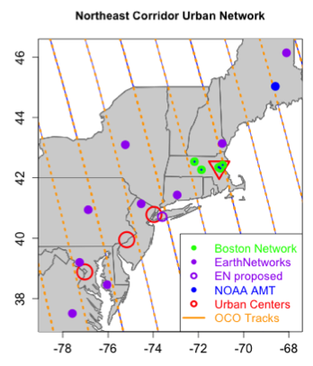
Progress towards regional scale carbon monitoring atmospheric validation: Year 2 results for the Northeast Corridor
Objective:
downscale the current NASA CMS flux products to the regional and local scales pertinent to Monitoring, Reporting, and Verification (MRV)
Approach:
focus on the Boston-DC megalopolis corridor
17% of the U.S. population, less than 2% of the land area
design a measurement network
develop an atmospheric modeling framework
High-resolution transport modeling
Mesoscale atmospheric model (WRF) coupled to Lagrangian particle dispersion model (STILT)
Verification includes PBL data from lidar profilers (MiniMPL)
High-resolution CO2 flux model incorporating
anthropogenic emissions estimates and the
CASA model (including its 0.5-deg resolution variant)
Inverse CO2 flux estimates

Slide 2
Prototype Monitoring, Reporting and Verification System for the Regional Scale: The Boston-DC Corridor
Institutions involved:

Slide 3
Observation Network Activities
Cross-calibration of Boston and Earth Networks GHG sensors
Compare measurements using Harvard and Earth Networks calibration gas tanks
Agreement to within 0.01 – 0.02 ppm
Completed second round of cross-calibrations in Year 2
GHG tower site on Long Island, NY
Continuously operating since installation during Year 1
Micro Pulse Lidar (miniMPLs) data acquisition and analysis:
Boston University (urban location, pre-existing installation)
Long Island (collocated with new GHG tower, Year 1 installation)
Lewisburg, PA (collocated with ENI GHG tower, upwind location)
Real-time acquisition of GHG and miniMPL data

Slide 4
Atmospheric Modeling Framework
Two WRF configurations selected for corridor runs
WRF model performance evaluation (see poster for details)
Cross-comparison of 3 different configurations (includes earlier Boston-Metro configuration
Comparison against standard meteorological observations
Non-standard observations:
miniMPL PBL height retrievals
ACARS commercial aircraft profiles: enhancements to WRF postprocessor and WRF-MET evaluation package
WRF-STILT transport computations
Enhancements for high-resolution emission inventory grids
Analysis of footprint sensitivity to WRF model configuration
Current Status:
WRF-STILT footprint computations for Observing network sites completed
Baseline WRF configuration
Baseline period: July 2013 – July 2014

Slide 5
WRF Modeling
Modeling framework: WRF model setup for corridor simulations
Nested (36km / 12km / 4km / 1.33km resolution) domains
Inner-most domain includes an urban canopy parameterization

Slide 6
WRF Modeling
1.33km resolution domain
model terrain height
urban fraction
Urban parameter database (NUDAPT-44)

Slide 7
STILT-footprints computed at 1km resolution
1-hour
6-hours (cumulative)
Artifacts of raw footprints:
time resolution (near-field, strong wind case)
under-sampling (far-field)
Interpolated/rescaled:
Employ time interpolation in near field, spatial averaging in far field
Fills in gaps, but retains near-field resolution
Far-field averaging length related to ensemble spread and ensemble size

Slide 8
Flux Modeling Framework
High resolution a priori flux estimates
Combine sources of information with high spatial and/or temporal resolution
Include estimates of biogenic fluxes in and near urban areas
Current Status:
Completed a two-year (2013/2014) dataset at 1 km spatial / 1 hour temporal resolution
Geographic coverage is for all states within the Washington DC – Boston urban corridor
Closely related DARTE product is available from TBD DAAC, and documented in PNAS article

Slide 9
Flux Modeling Framework
Includes 9 separate anthropogenic sectors:
On-road *
Human respiration +
Oil/gas +
Point sources *
Off-road *
Industrial non-point *
Air/ship *
Residential *
Commercial *
- same category as in Vulcan, + - not in Vulcan
Two alternate biosphere estimates
CASA-based inventory
Generated using high-resolution driver fields
VPRM based inventory

Slide 10
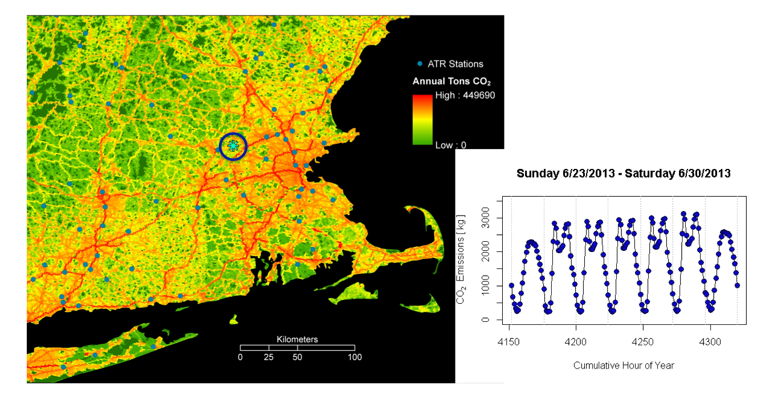
Flux modeling: FFCO2

Slide 11
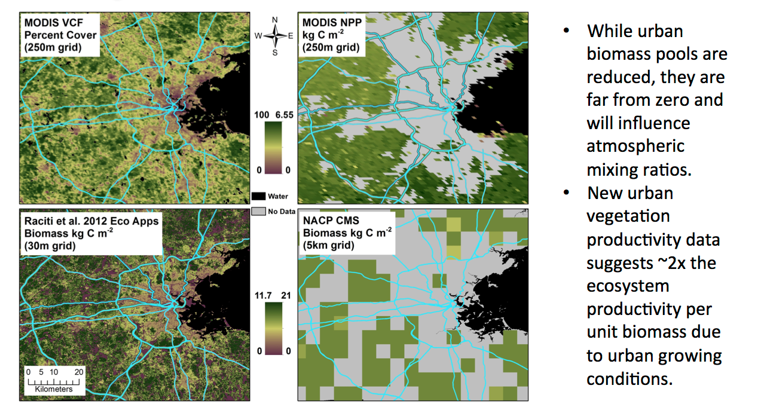
Flux modeling: Biosphere

Slide 12
Top-Down Inversion Framework
Top-down inversions builds on prior work for estimates of urban-scale methane leaks from Natural Gas distribution network
Results provided to TBD DAAC
Documented in PNAS article:
Extended to CO2 emissions for urban corridor
Boundary condition estimates incorporate vertical gradient information:

Slide 13
Stakeholder engagement
Presentations/Briefings based on results of Boston Methane study, and during the creation of the bottom-up inventory:
New England Conference of Public Utility Commissioners
National Grid
Boston Bar Association
City of Boston Environment Department
Board of Directors for the Boston Metropolitan Planning Organization
Environmental Defense Fund
Technical contacts with relevant local and state governments
e.g., extensive cell-phone based traffic flow data was provided by the Boston Metropolitan Planning Organization

Slide 14
Next steps:
Observing Network
Continued monitoring of GHG and miniMPL sites
Incorporate FTS and OCO-2 data into analysis
Modeling Framework
Extend baseline computation to full 2-year period
Examine additional WRF configurations
Flux modeling: refinements of initial baseline estimates
Top-down inversions
Treatment of boundary conditions
Use inflow measurements at tower sites, combine with CT vertical gradient information
consider alternate estimates and/or simultaneous optimization
Inversion methodologies:
Linear rescaling
Bayesian/geo-statistical (with appropriate constraints on dof)
Stakeholder engagement
Identify and reach out to additional stakeholders (e.g., municipal and state agencies with mitigation plans, RGGI)
Identify areas of future collaboration with stakeholders
Provide study results and methodologies
Identify potential data sources for emission inventories

